Slide 1













Managing
Multihoming
Workers in the
Gig Economy
Park Sinchaisri
UC Berkeley
joint work with Gad Allon, Maxime Cohen, Ken Moon
2021 INFORMS Annual Meeting

Slide 2

Multihoming
Workers
Notes:
You may have seen your ride-hailing driver having all the other apps up there to see the best opportunity and switching in real time. The behavior is usually called “multihoming”. [CLICK]
It’s getting more intense in cities like New York, where in 2018, the City Council voted to stop issuing new licenses for ride-hailing drivers for a year, and extended for another year. This means that gig companies will have to fight over the limited pool of workers.
As a growing number of platforms access the same pool of workers to complete their gigs, the question of how workers choose between competing platforms has grown in salience. However, cross-platform multihoming behavior has been difficult to empirically trace and analyze.

Slide 3

Multihoming
Workers

Slide 4









Multihoming
Workers

Slide 5
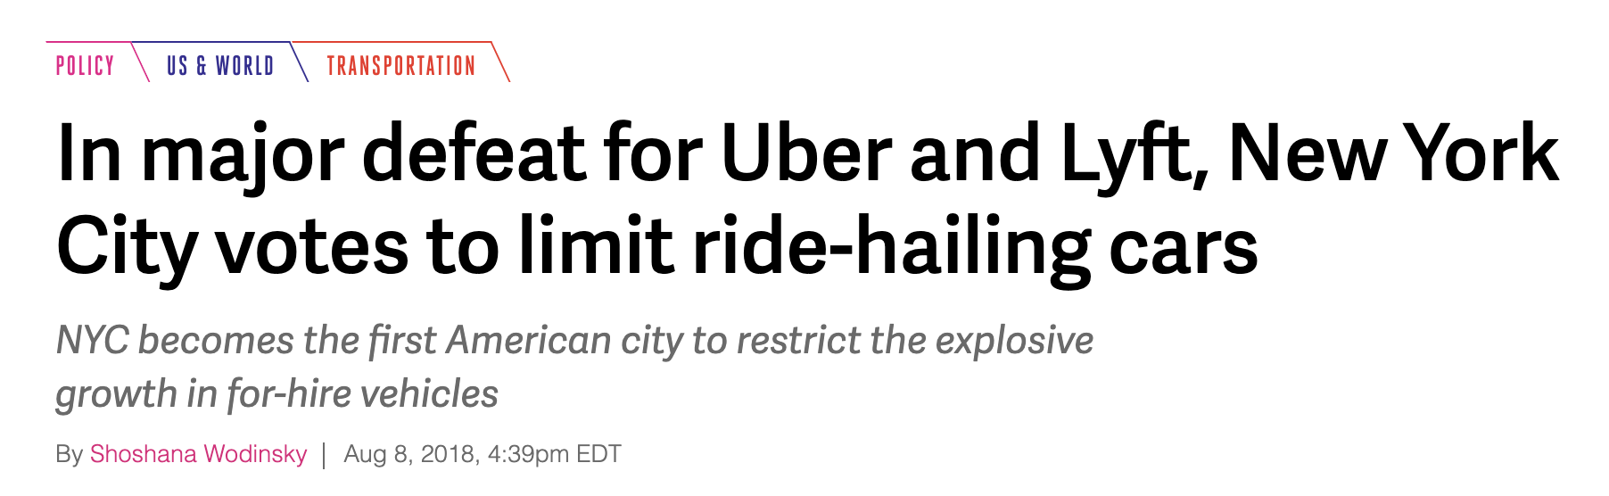

Slide 6
How should platforms
compete for multihoming workers?

Slide 7
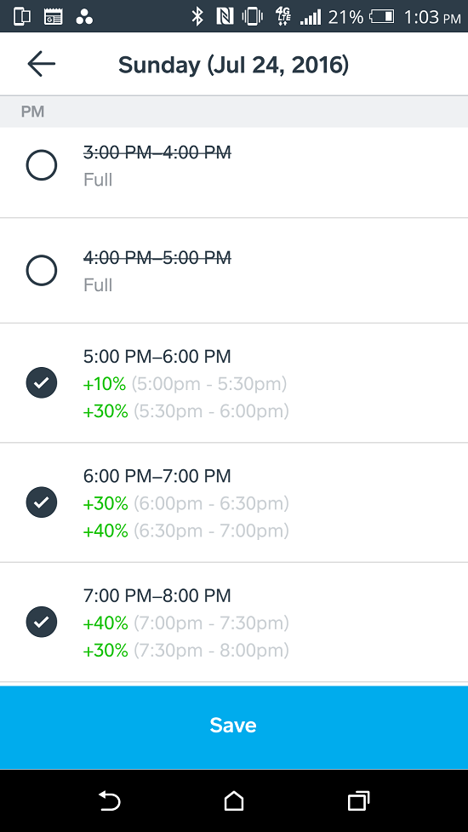


How should platforms
compete for multihoming workers?

Slide 8

How should platforms
compete for multihoming workers?

Slide 9
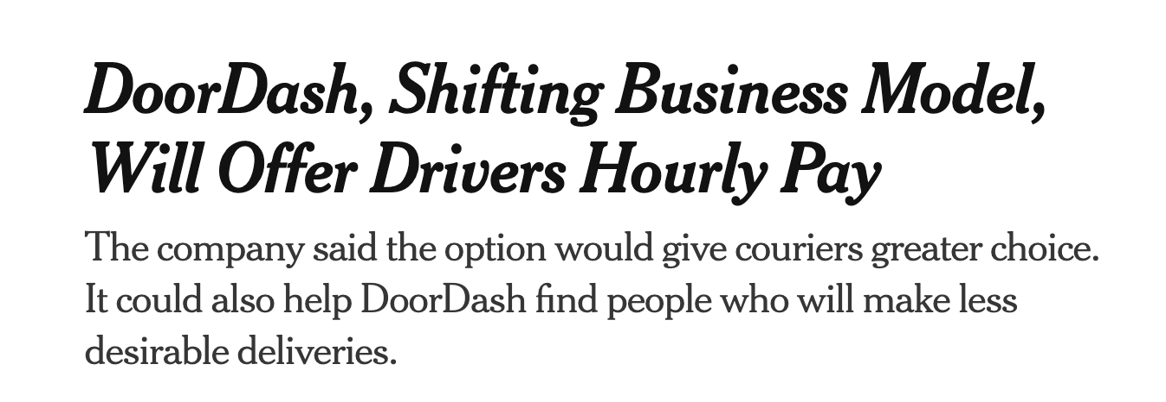

How should platforms
compete for multihoming workers?

Slide 10
How workers make
multihoming decisions?
How should platforms
compete for multihoming workers?
Notes:
To answer this question, The first step is to better understand how gig workers actually make decisions.

Slide 11
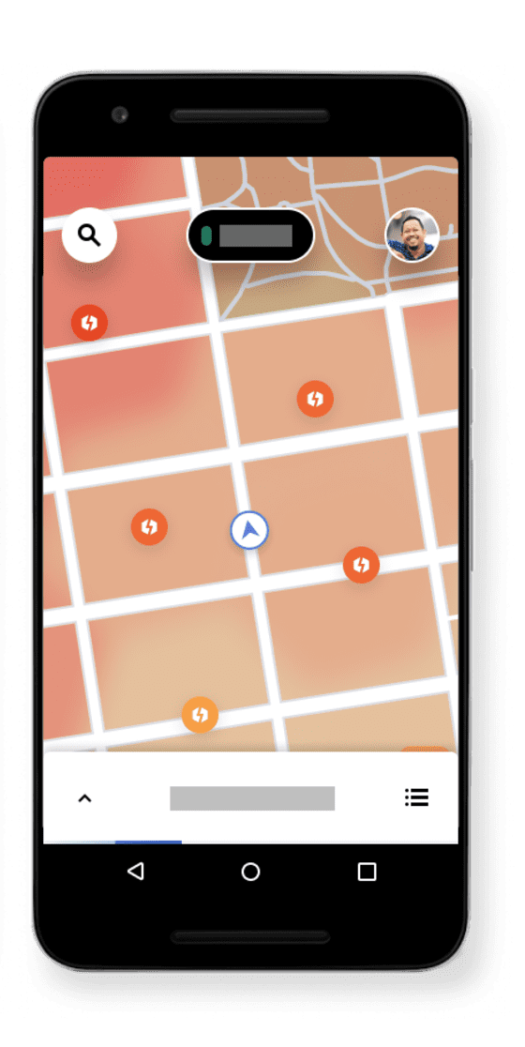
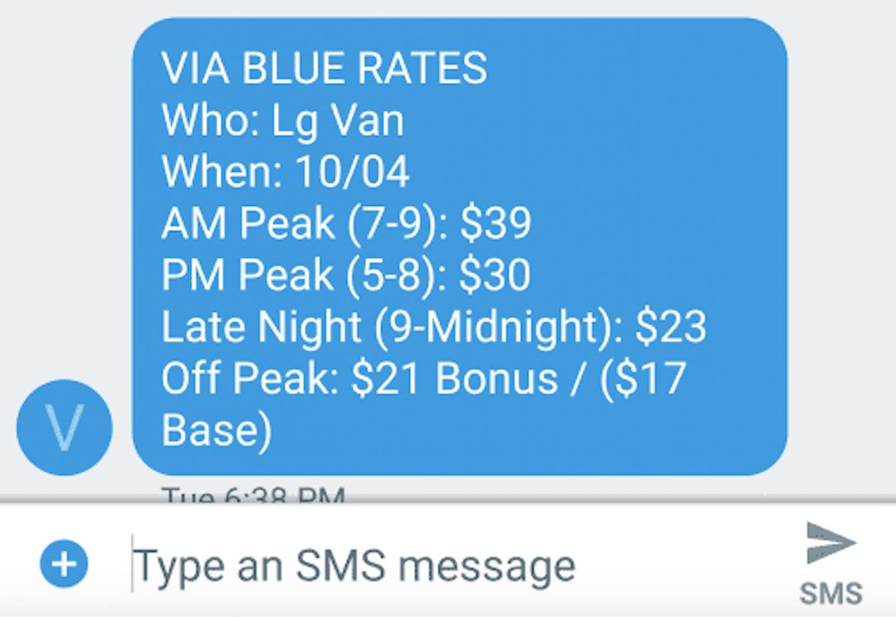
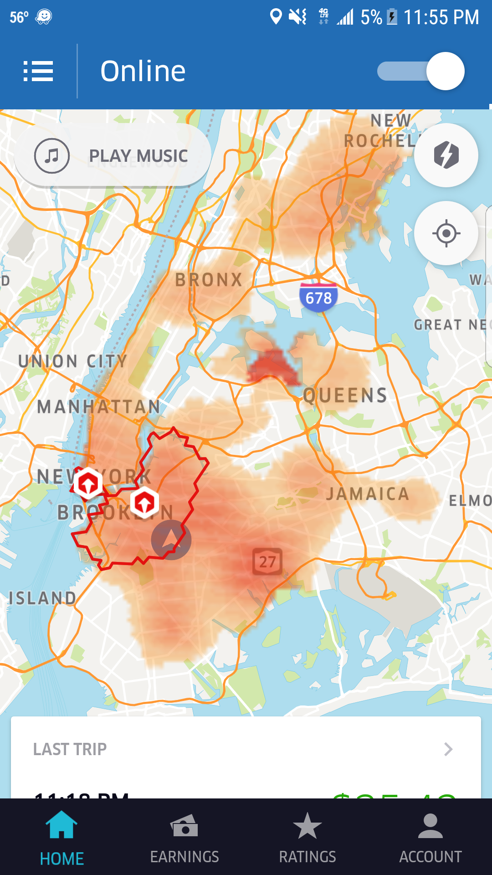
Context
Ride-Hailing w/ Diff. Pay
B = Competitor
A = Focal
B
A
Park S.
Notes:
We consider a setting where gig workers have two work options, which are both ride-hailing platforms.
We refer to the focal firm which is our industry partner as Firm A and the competing firm as firm B.
Quickly the difference

Slide 12
Context
Ride-Hailing w/ Diff. Pay
B = Competitor
A = Focal
B
A
dynamic guaranteed hourly pay
(e.g., $25/hour if online between 7-9am)
Park S.
Notes:
We consider a setting where gig workers have two work options, which are both ride-hailing platforms.
We refer to the focal firm which is our industry partner as Firm A and the competing firm as firm B.
Quickly the difference

Slide 13
Context
Ride-Hailing w/ Diff. Pay
B = Competitor
A = Focal
B
A
dynamic guaranteed hourly pay
(e.g., $25/hour if online between 7-9am)
dynamic per-trip pay
(e.g., base fare + extra $/minute + extra $/distance)
Park S.
Notes:
We consider a setting where gig workers have two work options, which are both ride-hailing platforms.
We refer to the focal firm which is our industry partner as Firm A and the competing firm as firm B.
Quickly the difference

Slide 14


Context
Gig Workers with 2 Options
(ride-hailing platforms)
B = Competitor
A = Focal
B
A
Park S.
225 S 4th St Brooklyn, NY
8:20AM
Notes:
We consider a setting where gig workers have two work options, which are both ride-hailing platforms.
We refer to the focal firm which is our industry partner as Firm A and the competing firm as firm B.
Quickly the difference

Slide 15
Context
Gig Workers with 2 Options
(ride-hailing platforms)
B = Competitor
A = Focal
B
A
$25/hour 7-9AM
Park S.
225 S 4th St Brooklyn, NY
8:20AM
Notes:
We consider a setting where gig workers have two work options, which are both ride-hailing platforms.
We refer to the focal firm which is our industry partner as Firm A and the competing firm as firm B.
Quickly the difference

Slide 16
Context
Gig Workers with 2 Options
(ride-hailing platforms)
B = Competitor
A = Focal
B
A
$25/hour 7-9AM
Avg. Surge
+25%
Park S.
225 S 4th St Brooklyn, NY
8:20AM
Notes:
We consider a setting where gig workers have two work options, which are both ride-hailing platforms.
We refer to the focal firm which is our industry partner as Firm A and the competing firm as firm B.
Quickly the difference

Slide 17
Context
Gig Workers with 2 Options
(ride-hailing platforms)
A = Focal
A
$25/hour 7-9AM
pick-up
Park S.
18 E Broadway New York, NY
A
225 S 4th St Brooklyn, NY
8:21AM
Notes:
We consider a setting where gig workers have two work options, which are both ride-hailing platforms.
We refer to the focal firm which is our industry partner as Firm A and the competing firm as firm B.
Quickly the difference

Slide 18
Context
Gig Workers with 2 Options
(ride-hailing platforms)
A = Focal
A
$25/hour 7-9AM
drop-off
4 Berry St Brooklyn, NY
Park S.
18 E Broadway New York, NY
8:40AM
Notes:
We consider a setting where gig workers have two work options, which are both ride-hailing platforms.
We refer to the focal firm which is our industry partner as Firm A and the competing firm as firm B.
Quickly the difference

Slide 19
Context
Gig Workers with 2 Options
(ride-hailing platforms)
A = Focal
A
4 Berry St Brooklyn, NY
Park S.
9:05AM
Notes:
We consider a setting where gig workers have two work options, which are both ride-hailing platforms.
We refer to the focal firm which is our industry partner as Firm A and the competing firm as firm B.
Quickly the difference

Slide 20
Context
Gig Workers with 2 Options
(ride-hailing platforms)
A = Focal
A
$15/hour 9-11AM
4 Berry St Brooklyn, NY
Park S.
9:05AM
Notes:
We consider a setting where gig workers have two work options, which are both ride-hailing platforms.
We refer to the focal firm which is our industry partner as Firm A and the competing firm as firm B.
Quickly the difference

Slide 21
Context
Gig Workers with 2 Options
(ride-hailing platforms)
B = Competitor
A = Focal
B
A
$15/hour 9-11AM
4 Berry St Brooklyn, NY
Avg. Surge
+75%
Park S.
9:05AM
Notes:
We consider a setting where gig workers have two work options, which are both ride-hailing platforms.
We refer to the focal firm which is our industry partner as Firm A and the competing firm as firm B.
Quickly the difference

Slide 22
Context
Gig Workers with 2 Options
(ride-hailing platforms)
B = Competitor
A = Focal
B
A
$15/hour 9-11AM
B
4 Berry St Brooklyn, NY
Avg. Surge
+75%
Park S.
9:05AM
Notes:
We consider a setting where gig workers have two work options, which are both ride-hailing platforms.
We refer to the focal firm which is our industry partner as Firm A and the competing firm as firm B.
Quickly the difference

Slide 23
Data
B = Competitor
A = Focal
B
A
July 2017, NYC
45k work sessions (consecutive online w/o breaks)
2,875 drivers
Time and location of first pick-up and last drop-off
Guaranteed hourly pay
Notes:
We’re leveraging two large datasets.
First, we have a data from our ride-hailing partner. For three months in 2017, we observe information about drivers’ work sessions, which are times they continuously work without a break. We know about their first and last trips for the session. [NEXT]
We then combine this with trip records data collected by the Taxi and Limousine commission in New York. They have platform ID but not driver ID, time and location of every trip done by every platform.
We also take price breakdowns from B's website to help us approximate prices for these trips.

Slide 24

Data
B = Competitor
A = Focal
B
A
July 2017, NYC
45k work sessions (consecutive online w/o breaks)
2,875 drivers
Time and location of first pick-up and last drop-off
Guaranteed hourly pay
Trip records data
35M ride-hailing trips
Platform ID
Time and location of every pick-up/drop-off
Per-trip pay
(Price breakdowns )
B
Notes:
We’re leveraging two large datasets.
First, we have a data from our ride-hailing partner. For three months in 2017, we observe information about drivers’ work sessions, which are times they continuously work without a break. We know about their first and last trips for the session. [NEXT]
We then combine this with trip records data collected by the Taxi and Limousine commission in New York. They have platform ID but not driver ID, time and location of every trip done by every platform.
We also take price breakdowns from B's website to help us approximate prices for these trips.

Slide 25
Data
B = Competitor
A = Focal
B
A
July 2017, NYC
45k work sessions (consecutive online w/o breaks)
2,875 drivers
Time and location of first pick-up and last drop-off
Guaranteed hourly pay
Trip records data
35M ride-hailing trips
Platform ID
Time and location of every pick-up/drop-off
Per-trip pay
(Price breakdowns )
measurement gap
B
Notes:
We’re leveraging two large datasets.
First, we have a data from our ride-hailing partner. For three months in 2017, we observe information about drivers’ work sessions, which are times they continuously work without a break. We know about their first and last trips for the session. [NEXT]
We then combine this with trip records data collected by the Taxi and Limousine commission in New York. They have platform ID but not driver ID, time and location of every trip done by every platform.
We also take price breakdowns from B's website to help us approximate prices for these trips.

Slide 26
Data
B = Competitor
A = Focal
B
A
July 2017, NYC
45k work sessions (consecutive online w/o breaks)
2,875 drivers
Time and location of first pick-up and last drop-off
Guaranteed hourly pay
Trip records data
35M ride-hailing trips
Platform ID
Time and location of every pick-up/drop-off
Per-trip pay
(Price breakdowns )
measurement gap
reconstructing missing work + outside options
B
Notes:
We’re leveraging two large datasets.
First, we have a data from our ride-hailing partner. For three months in 2017, we observe information about drivers’ work sessions, which are times they continuously work without a break. We know about their first and last trips for the session. [NEXT]
We then combine this with trip records data collected by the Taxi and Limousine commission in New York. They have platform ID but not driver ID, time and location of every trip done by every platform.
We also take price breakdowns from B's website to help us approximate prices for these trips.

Slide 27

Trip records data
35M ride-hailing trips
Platform ID
Time and location of every pick-up/drop-off
Chelsea
10am
Notes:
We’re leveraging two large datasets.
First, we have a data from our ride-hailing partner. For three months in 2017, we observe information about drivers’ work sessions, which are times they continuously work without a break. We know about their first and last trips for the session. [NEXT]
We then combine this with trip records data collected by the Taxi and Limousine commission in New York. They have platform ID but not driver ID, time and location of every trip done by every platform.
We also take price breakdowns from B's website to help us approximate prices for these trips.

Slide 28
# dropoffs on B
Trip records data
35M ride-hailing trips
Platform ID
Time and location of every pick-up/drop-off
Chelsea
10am
Notes:
We’re leveraging two large datasets.
First, we have a data from our ride-hailing partner. For three months in 2017, we observe information about drivers’ work sessions, which are times they continuously work without a break. We know about their first and last trips for the session. [NEXT]
We then combine this with trip records data collected by the Taxi and Limousine commission in New York. They have platform ID but not driver ID, time and location of every trip done by every platform.
We also take price breakdowns from B's website to help us approximate prices for these trips.

Slide 29
# dropoffs on B
# pickups on B
Trip records data
35M ride-hailing trips
Platform ID
Time and location of every pick-up/drop-off
Chelsea
10am
Notes:
We’re leveraging two large datasets.
First, we have a data from our ride-hailing partner. For three months in 2017, we observe information about drivers’ work sessions, which are times they continuously work without a break. We know about their first and last trips for the session. [NEXT]
We then combine this with trip records data collected by the Taxi and Limousine commission in New York. They have platform ID but not driver ID, time and location of every trip done by every platform.
We also take price breakdowns from B's website to help us approximate prices for these trips.

Slide 30
# dropoffs on B
# pickups on B
Trip records data
35M ride-hailing trips
Platform ID
Time and location of every pick-up/drop-off
Chelsea
B needs to incentivize more drivers to start working here
(proxy for supply shortage)
10am
Notes:
We’re leveraging two large datasets.
First, we have a data from our ride-hailing partner. For three months in 2017, we observe information about drivers’ work sessions, which are times they continuously work without a break. We know about their first and last trips for the session. [NEXT]
We then combine this with trip records data collected by the Taxi and Limousine commission in New York. They have platform ID but not driver ID, time and location of every trip done by every platform.
We also take price breakdowns from B's website to help us approximate prices for these trips.

Slide 31
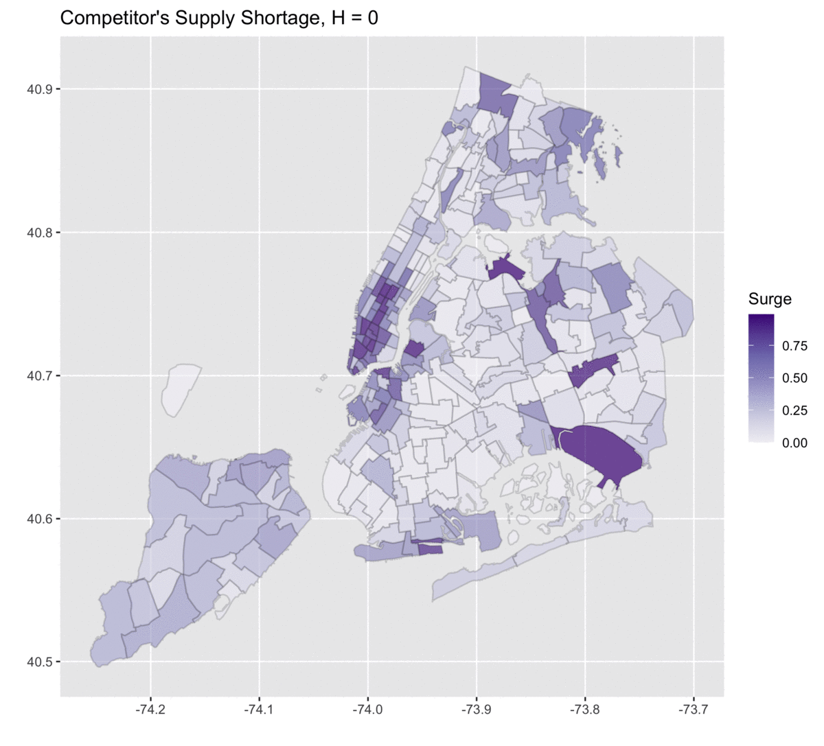
P(Supply shortage on competitor)
B
Notes:
With these datasets, we can look at how time and location play a role in the market conditions and in workers’ decisions. On the left, we have how likely there would be a supply shortage at the competing firm, which may indicate a potential surge pricing there.
On the right, how likely drivers on A are to quit working at each location and time.
Our identification strategy, to explain the right map by the left map, relies on these temporal and spatial variations of the values of working for both platforms.

Slide 32
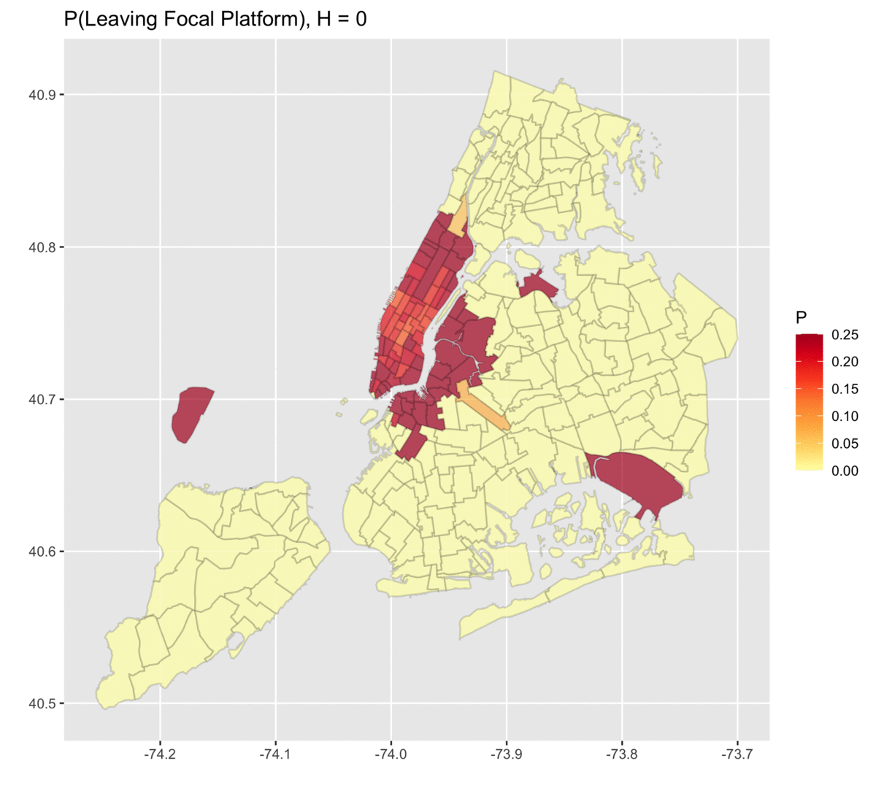
Temporal/Spatial Variations
P(Supply shortage on competitor)
P(Leaving focal firm)
B
A
Notes:
With these datasets, we can look at how time and location play a role in the market conditions and in workers’ decisions. On the left, we have how likely there would be a supply shortage at the competing firm, which may indicate a potential surge pricing there.
On the right, how likely drivers on A are to quit working at each location and time.
Our identification strategy, to explain the right map by the left map, relies on these temporal and spatial variations of the values of working for both platforms.

Slide 33
Structural Model + Estimation
of Dynamic Decisions
Notes:
Now I’ll first introduce the key parameters that characterize our ride-hailing drivers.
[5 mins]

Slide 34

Our Model
2 firms in the same industry
Finite time horizon, every 20 mins
A = Focal
Work for A
Task
Info
Notes:
We start with a worker who chose to work for A [CLICK] and then they would be working on a task. [CLICK] Then, they can decide whether to stay with the focal platform, switch over to B, or leaving the market.
If the worker chooses to switch from A to B, then they enter a similar model with the task and the decisions. For today’s talk, we assume that once the worker left A for B, they won’t return back to A. This is what we observed from our data and from talking to the drivers in NY
we’ll start modeling the competing platform first.
[they tend to drive one long session for firm A rather than doing multiple shorter sessions.]

Slide 35
Our Model
2 firms in the same industry
Finite time horizon, every 20 mins
A = Focal
Stay with A
Work for A
Decide
Task
Info
Notes:
We start with a worker who chose to work for A [CLICK] and then they would be working on a task. [CLICK] Then, they can decide whether to stay with the focal platform, switch over to B, or leaving the market.
If the worker chooses to switch from A to B, then they enter a similar model with the task and the decisions. For today’s talk, we assume that once the worker left A for B, they won’t return back to A. This is what we observed from our data and from talking to the drivers in NY
we’ll start modeling the competing platform first.
[they tend to drive one long session for firm A rather than doing multiple shorter sessions.]

Slide 36
Our Model
2 firms in the same industry
Finite time horizon, every 20 mins
A = Focal
Stay with A
Work for A
Decide
Task
Info
Quit
Leave market
Notes:
We start with a worker who chose to work for A [CLICK] and then they would be working on a task. [CLICK] Then, they can decide whether to stay with the focal platform, switch over to B, or leaving the market.
If the worker chooses to switch from A to B, then they enter a similar model with the task and the decisions. For today’s talk, we assume that once the worker left A for B, they won’t return back to A. This is what we observed from our data and from talking to the drivers in NY
we’ll start modeling the competing platform first.
[they tend to drive one long session for firm A rather than doing multiple shorter sessions.]

Slide 37
Our Model
2 firms in the same industry
Finite time horizon, every 20 mins
A = Focal
B = Competitor
Stay with A
Work for A
Decide
Task
Switch to B
Task
Info
Quit
Info
Leave market
Notes:
We start with a worker who chose to work for A [CLICK] and then they would be working on a task. [CLICK] Then, they can decide whether to stay with the focal platform, switch over to B, or leaving the market.
If the worker chooses to switch from A to B, then they enter a similar model with the task and the decisions. For today’s talk, we assume that once the worker left A for B, they won’t return back to A. This is what we observed from our data and from talking to the drivers in NY
we’ll start modeling the competing platform first.
[they tend to drive one long session for firm A rather than doing multiple shorter sessions.]

Slide 38
Our Model
2 firms in the same industry
Finite time horizon, every 20 mins
A = Focal
B = Competitor
Stay with A
Stay with B
Work for A
Decide
Decide
Task
Switch to B
Task
Info
Quit
Info
Quit
Leave market
Notes:
We start with a worker who chose to work for A [CLICK] and then they would be working on a task. [CLICK] Then, they can decide whether to stay with the focal platform, switch over to B, or leaving the market.
If the worker chooses to switch from A to B, then they enter a similar model with the task and the decisions. For today’s talk, we assume that once the worker left A for B, they won’t return back to A. This is what we observed from our data and from talking to the drivers in NY
we’ll start modeling the competing platform first.
[they tend to drive one long session for firm A rather than doing multiple shorter sessions.]

Slide 39
Our Model
2 firms in the same industry
Finite time horizon, every 20 mins
A = Focal
B = Competitor
Stay with A
Stay with B
Work for A
Decide
Decide
Task
Switch to B
Task
Info
Quit
Info
Quit
Leave market
Notes:
We start with a worker who chose to work for A [CLICK] and then they would be working on a task. [CLICK] Then, they can decide whether to stay with the focal platform, switch over to B, or leaving the market.
If the worker chooses to switch from A to B, then they enter a similar model with the task and the decisions. For today’s talk, we assume that once the worker left A for B, they won’t return back to A. This is what we observed from our data and from talking to the drivers in NY
we’ll start modeling the competing platform first.
[they tend to drive one long session for firm A rather than doing multiple shorter sessions.]

Slide 40
Our Model
2 firms in the same industry
Finite time horizon, every 20 mins
A = Focal
B = Competitor
Stay with A
Stay with B
Work for A
Decide
Decide
Task
Switch to B
Task
Info
V^{Aquit} = 0
Info
V^{Bquit} = 0
Leave market
Notes:
We start with a worker who chose to work for A [CLICK] and then they would be working on a task. [CLICK] Then, they can decide whether to stay with the focal platform, switch over to B, or leaving the market.
If the worker chooses to switch from A to B, then they enter a similar model with the task and the decisions. For today’s talk, we assume that once the worker left A for B, they won’t return back to A. This is what we observed from our data and from talking to the drivers in NY
we’ll start modeling the competing platform first.
[they tend to drive one long session for firm A rather than doing multiple shorter sessions.]

Slide 41
Our Model
2 firms in the same industry
Finite time horizon, every 20 mins
A = Focal
B = Competitor
cost to work
Stay with A
V^{Bwork} = -C_{i} + RβE[pay] + (1-R) βV_{t+1}
Work for A
Decide
Decide
Task
Task
match
Switch to B
no match
discount factor
Info
V^{Aquit} = 0
Info
V^{Bquit} = 0
Leave market
Notes:
We start with a worker who chose to work for A [CLICK] and then they would be working on a task. [CLICK] Then, they can decide whether to stay with the focal platform, switch over to B, or leaving the market.
If the worker chooses to switch from A to B, then they enter a similar model with the task and the decisions. For today’s talk, we assume that once the worker left A for B, they won’t return back to A. This is what we observed from our data and from talking to the drivers in NY
we’ll start modeling the competing platform first.
[they tend to drive one long session for firm A rather than doing multiple shorter sessions.]

Slide 42
Our Model
2 firms in the same industry
Finite time horizon, every 20 mins
A = Focal
B = Competitor
cost to work
Stay with A
V^{Bwork} = -C_{i} + RβE[pay] + (1-R) βV_{t+1}
Work for A
Decide
Decide
Task
Task
match
V^{Bwork}
no match
discount factor
Info
V^{Aquit} = 0
Info
V^{Bquit} = 0
Leave market
Notes:
We start with a worker who chose to work for A [CLICK] and then they would be working on a task. [CLICK] Then, they can decide whether to stay with the focal platform, switch over to B, or leaving the market.
If the worker chooses to switch from A to B, then they enter a similar model with the task and the decisions. For today’s talk, we assume that once the worker left A for B, they won’t return back to A. This is what we observed from our data and from talking to the drivers in NY
we’ll start modeling the competing platform first.
[they tend to drive one long session for firm A rather than doing multiple shorter sessions.]

Slide 43
Our Model
2 firms in the same industry
Finite time horizon, every 20 mins
A = Focal
B = Competitor
cost to work
V^{Awork} = w -C_{i} + RβE[pay] + (1-R) βV_{t+1}
cost to work
V^{Bwork} = -C_{i} + RβE[pay] + (1-R) βV_{t+1}
Work for A
Decide
Decide
Task
V^{Bwork}
discount factor
Task
discount factor
Info
V^{Aquit} = 0
Info
V^{Bquit} = 0
Leave market
Notes:
We start with a worker who chose to work for A [CLICK] and then they would be working on a task. [CLICK] Then, they can decide whether to stay with the focal platform, switch over to B, or leaving the market.
If the worker chooses to switch from A to B, then they enter a similar model with the task and the decisions. For today’s talk, we assume that once the worker left A for B, they won’t return back to A. This is what we observed from our data and from talking to the drivers in NY
we’ll start modeling the competing platform first.
[they tend to drive one long session for firm A rather than doing multiple shorter sessions.]

Slide 44
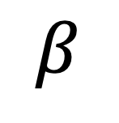
Our Model
Drivers’ Parameters
$$β$$
homogeneous
discount / forward-looking factor
Notes:
We first assume that every driver has the same discount factor beta. So, they are all the same on how forward-looking they are
We model the heterogeneity of these drivers by their individual cost of working for a unit time interval. [CLICK]
So all drivers have their own costs, and these costs are drawn from a truncated normal with parameters mu and sigma^2.
Essentially, we’re going to estimate these 3 parameters: beta, mu, and sigma.

Slide 45
Our Model
Drivers’ Parameters
$$β$$
homogeneous
discount / forward-looking factor
heterogeneous
C_{i}
cost of working for a unit time interval
Notes:
We first assume that every driver has the same discount factor beta. So, they are all the same on how forward-looking they are
We model the heterogeneity of these drivers by their individual cost of working for a unit time interval. [CLICK]
So all drivers have their own costs, and these costs are drawn from a truncated normal with parameters mu and sigma^2.
Essentially, we’re going to estimate these 3 parameters: beta, mu, and sigma.

Slide 46

Our Model
Drivers’ Parameters
$$β$$
homogeneous
discount / forward-looking factor
heterogeneous
C_{i}
cost of working for a unit time interval
C₁
C₂
C₃
C₄
~ Truncated Normal (𝜇,𝜎²)
Notes:
We first assume that every driver has the same discount factor beta. So, they are all the same on how forward-looking they are
We model the heterogeneity of these drivers by their individual cost of working for a unit time interval. [CLICK]
So all drivers have their own costs, and these costs are drawn from a truncated normal with parameters mu and sigma^2.
Essentially, we’re going to estimate these 3 parameters: beta, mu, and sigma.

Slide 47
Estimation
Drivers’ Parameters
$$β$$
homogeneous
discount / forward-looking factor
heterogeneous
C_{i}
cost of working for a unit time interval
C₁
C₂
C₃
C₄
~ Truncated Normal (𝜇,𝜎²)
Notes:
We first assume that every driver has the same discount factor beta. So, they are all the same on how forward-looking they are
We model the heterogeneity of these drivers by their individual cost of working for a unit time interval. [CLICK]
So all drivers have their own costs, and these costs are drawn from a truncated normal with parameters mu and sigma^2.
Essentially, we’re going to estimate these 3 parameters: beta, mu, and sigma.

Slide 48
Our Model
Drivers’ Parameters
$$β$$
homogeneous
discount / forward-looking factor
heterogeneous
C_{i}
cost of working for a unit time interval
C₁
C₂
C₃
C₄
~ Truncated Normal (𝜇,𝜎²)
Notes:
We first assume that every driver has the same discount factor beta. So, they are all the same on how forward-looking they are
We model the heterogeneity of these drivers by their individual cost of working for a unit time interval. [CLICK]
So all drivers have their own costs, and these costs are drawn from a truncated normal with parameters mu and sigma^2.
Essentially, we’re going to estimate these 3 parameters: beta, mu, and sigma.

Slide 49
Outcome of Interest
For each day, fraction of drivers quitting at (H,L)
Data
H x L
Hours: 7am to 11pm
(Remaining left at 11:59pm)
Location: 1 of 20 regions
Quitting Hour
Bronx, Brooklyn, Newark, Central Park, Chelsea, Downtown, Governors Island, Gramercy, Harlem, LES, LWS, Midtown, Morningside Heights, UES, UWS, Upper Manhattan, JFK, LaGuardia, Queens, Staten Island
Quitting location
Notes:
Here, we’re looking at what fraction of drivers who have been working for the focal firm quitting at different time and location each day. [CLICK]
H refers to the hours, from 7am to 11pm, [CLICK] and L refers to location which is one of the 20 regions in NYC. [CLICK]
Now from the actual data, we can generate a heatmap like this for each day, where each cell represents the true fraction of drivers quitting at particular time and location.

Slide 50
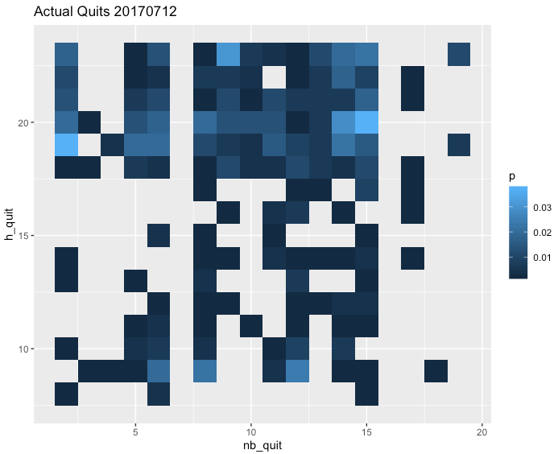
Outcome of Interest
For each day, fraction of drivers quitting at (H,L)
Data
H x L
Hours: 7am to 11pm
(Remaining left at 11:59pm)
Location: 1 of 20 regions
Quitting Hour
Bronx, Brooklyn, Newark, Central Park, Chelsea, Downtown, Governors Island, Gramercy, Harlem, LES, LWS, Midtown, Morningside Heights, UES, UWS, Upper Manhattan, JFK, LaGuardia, Queens, Staten Island
Quitting location
Each cell (H,L) is fraction of drivers quitting at location L and hour H: f_{L,H}
Notes:
Here, we’re looking at what fraction of drivers who have been working for the focal firm quitting at different time and location each day. [CLICK]
H refers to the hours, from 7am to 11pm, [CLICK] and L refers to location which is one of the 20 regions in NYC. [CLICK]
Now from the actual data, we can generate a heatmap like this for each day, where each cell represents the true fraction of drivers quitting at particular time and location.

Slide 51
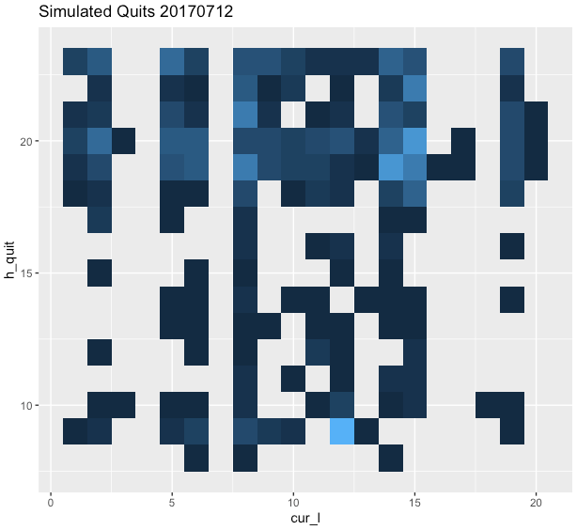


Data
Simulation (given $θ$)
Simulation (given $θ$)
Quitting Hour
Quitting Hour
Quitting location
Quitting location
Notes:
The eventual goal is that we want to find parameters that minimize the distance function between the data and the simulation.
Many common estimation methods still suffer from the curse of dimensionality in models with rich heterogeneity and the convergence is not guaranteed or can be extremely slow.
So, we will resort to a better way to learn from data: machine learning.

Slide 52
Data
Simulation (given $θ$)
Simulation (given $θ$)
Quitting Hour
Quitting Hour
Quitting location
Quitting location
Find 𝜃 that minimizes distance
Notes:
The eventual goal is that we want to find parameters that minimize the distance function between the data and the simulation.
Many common estimation methods still suffer from the curse of dimensionality in models with rich heterogeneity and the convergence is not guaranteed or can be extremely slow.
So, we will resort to a better way to learn from data: machine learning.

Slide 53
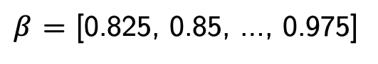
Simulating Decisions
B x C
$β$ = [0.825, 0.85, …, 0.975]
x C = [0, 0.25, …, 5]
Grid value
For each ($β$,C), simulate each driver’s decision 100 times
H x L
Distribution of quitting time and location for each driver across 100 simulations.
Day 1
Quitting Hour
Quitting location
…
H x L
Day T
Quitting Hour
Quitting location
Notes:
To help us solve computational challenges, we did a lot a lot of pre-computationfor a grid of BETA and COSTS values.
For each pair, we simulate each driver’s decision 100 times for each day. For one driver, we can generate the distribution of when and where he’s quitting across 100 runs.
We can then do the same for the rest of the days, and also for the rest of the drivers in the data.

Slide 54
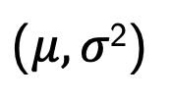
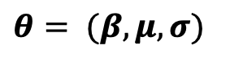
Simulating Decisions
$$θ= (β,μ,σ)$$
Draw all C_{i} from TruncatedNormal
For a given
b₁,c₂
b₂,c₂
C₁
𝛽,C₁
B x C grid of pre-computed decisions
𝛽,C₁
b₁,c₁
b₂,c₁
Notes:
In the actual simulation, given a set of parameters theta, we first draw each driver’s cost from a truncated normal with mean mu and variance sigma^2.
For the driver i with cost c_i, we revisit our pre-computed distributions. We can find the four nearest points to the pair (beta and C_i)
The new distribution of quitting decision given beta and C_i would be a linear interpolation of the four distributions associated with those four points, based on those distances.

Slide 55
Simulating Decisions
$$θ= (β,μ,σ)$$
Draw all C_{i} from TruncatedNormal
For a given
b₁,c₂
b₂,c₂
C₁
𝛽,C₁
B x C grid of pre-computed decisions
𝛽,C₁
b₁,c₁
b₂,c₁
b₁,c₁
b₁,c₂
b₂,c₁
b₂,c₂
H x L
= Linear Interpolation
H x L
H x L
H x L
H x L
(
)
Quitting Hour
Quitting location
Distributions of quitting time and location for each driver across 100 simulations.
Notes:
In the actual simulation, given a set of parameters theta, we first draw each driver’s cost from a truncated normal with mean mu and variance sigma^2.
For the driver i with cost c_i, we revisit our pre-computed distributions. We can find the four nearest points to the pair (beta and C_i)
The new distribution of quitting decision given beta and C_i would be a linear interpolation of the four distributions associated with those four points, based on those distances.

Slide 56
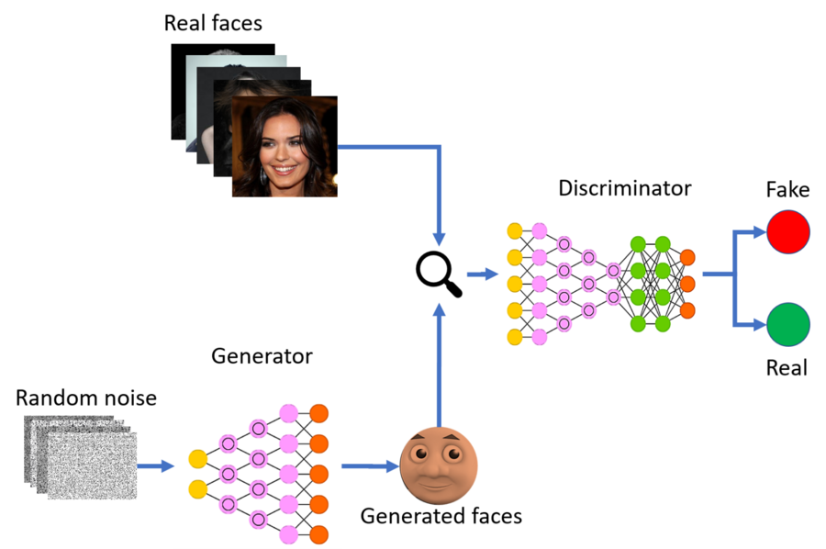
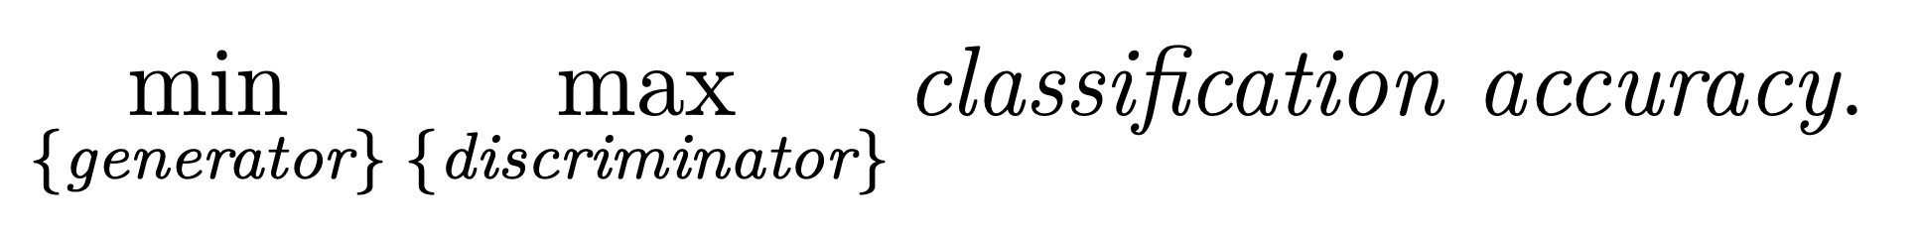
Goodfellow et al (2014)
Gen. Adversarial Networks
“D”
“G”
Notes:
the algorithm we will use is called a generative adversarial network or GAN. Its framework is a minimax game between two players over classification accuracy.
The purpose of GAN is to generate artificial data like images that look real. Our goal here is to obtain estimates of structural model that can generate data that look real, as if it was produced by real workers.
The generator is an algorithm to simulate synthetic data; its objective is to find a data-generating algorithm that confuses the discriminator. The discriminator is a classification algorithm that distinguishes observed data from simulated data; it takes a data point as input and classifies if it comes from observed data or simulated data; its objective is to maximize the accuracy of its classification.

Slide 57
Kaji, Manresa & Pouliot (2020)
Adversarial Estimation
“D”
“G”
Notes:
the algorithm we will use is called a generative adversarial network or GAN. Its framework is a minimax game between two players over classification accuracy.
The purpose of GAN is to generate artificial data like images that look real. Our goal here is to obtain estimates of structural model that can generate data that look real, as if it was produced by real workers.
The generator is an algorithm to simulate synthetic data; its objective is to find a data-generating algorithm that confuses the discriminator. The discriminator is a classification algorithm that distinguishes observed data from simulated data; it takes a data point as input and classifies if it comes from observed data or simulated data; its objective is to maximize the accuracy of its classification.

Slide 58
Kaji, Manresa & Pouliot (2020)
Adversarial Estimation
Data
“D”
X
Quitting Hour
Quitting location
Notes:
the algorithm we will use is called a generative adversarial network or GAN. Its framework is a minimax game between two players over classification accuracy.
The purpose of GAN is to generate artificial data like images that look real. Our goal here is to obtain estimates of structural model that can generate data that look real, as if it was produced by real workers.
The generator is an algorithm to simulate synthetic data; its objective is to find a data-generating algorithm that confuses the discriminator. The discriminator is a classification algorithm that distinguishes observed data from simulated data; it takes a data point as input and classifies if it comes from observed data or simulated data; its objective is to maximize the accuracy of its classification.

Slide 59
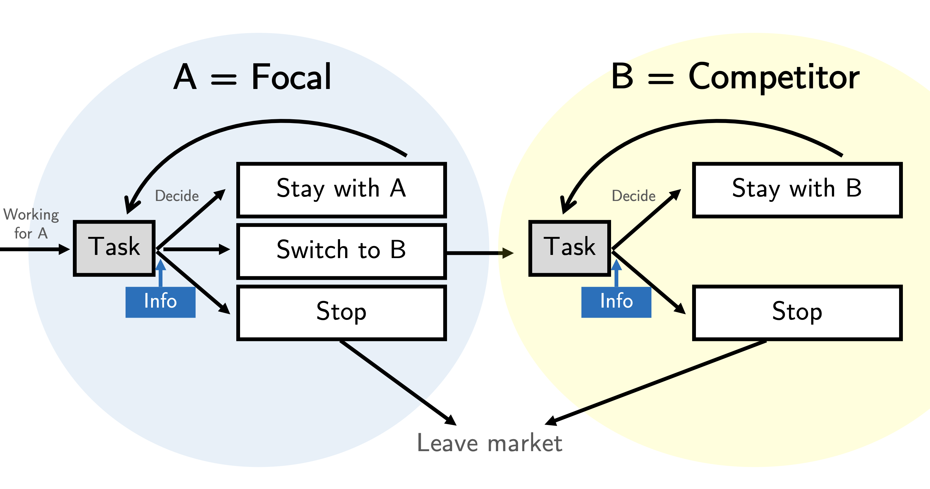

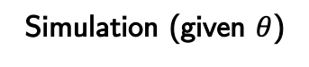
Kaji, Manresa & Pouliot (2020)
Adversarial Estimation
Data
“D”
X
Quitting Hour
Quitting location
Simulation (given $θ$)
Quitting Hour
X
“G” = structural model
Quitting location
Notes:
the algorithm we will use is called a generative adversarial network or GAN. Its framework is a minimax game between two players over classification accuracy.
The purpose of GAN is to generate artificial data like images that look real. Our goal here is to obtain estimates of structural model that can generate data that look real, as if it was produced by real workers.
The generator is an algorithm to simulate synthetic data; its objective is to find a data-generating algorithm that confuses the discriminator. The discriminator is a classification algorithm that distinguishes observed data from simulated data; it takes a data point as input and classifies if it comes from observed data or simulated data; its objective is to maximize the accuracy of its classification.

Slide 60
Kaji, Manresa & Pouliot (2020)
Adversarial Estimation
Data
“D”
X
Quitting Hour
Simulated
Y = 0
Quitting location
Y = 1
Simulation (given $θ$)
Quitting Hour
X
“G” = structural model
Quitting location
Notes:
the algorithm we will use is called a generative adversarial network or GAN. Its framework is a minimax game between two players over classification accuracy.
The purpose of GAN is to generate artificial data like images that look real. Our goal here is to obtain estimates of structural model that can generate data that look real, as if it was produced by real workers.
The generator is an algorithm to simulate synthetic data; its objective is to find a data-generating algorithm that confuses the discriminator. The discriminator is a classification algorithm that distinguishes observed data from simulated data; it takes a data point as input and classifies if it comes from observed data or simulated data; its objective is to maximize the accuracy of its classification.

Slide 61
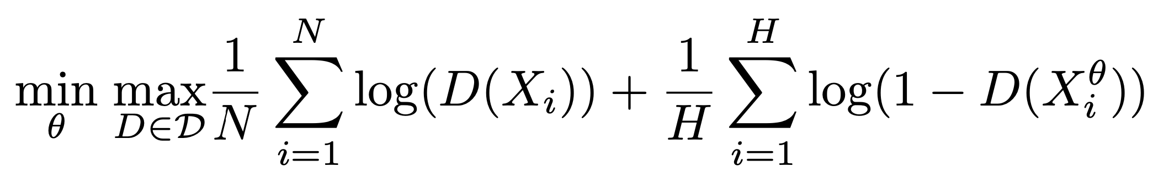
Kaji, Manresa & Pouliot (2020)
Adversarial Estimation
Real Data
Simulated Data
Data
“D”
X
Quitting Hour
Simulated
Y = 0
Quitting location
Y = 1
Simulation (given $θ$)
Quitting Hour
X
“G” = structural model
Quitting location
Notes:
So these real faces are like our actual data. [CLICK]
And generated faces are like our simulation output. [CLICK]
Here we adopt an approach called Adversarial Estimation recently proposed by Kaji et al.
One player is a discriminator “D” that looks the data and determines whether the data is real or simulated. Like the original GAN, We choose NN that gives us the probability that X is drawn from the real data.
The other player is a generator “G” that produces simulated data and is trained to confuse the discriminator.
We use our structural model that we want to estimate as G.
How do we define this estimator. ?
Our neural network is specified with a three-unit dense layer followed by a batch normalization and the leakyReLu activation function. We use a dropout rate of 40% between the first and the second block of dense. The dense, batch normalization, leakyReLu, and dropout pattern are repeated for three hidden layers before the last sigmoid output later. These are trained with a batch size of 32. To train the generator network, we use the gradient from the discriminator model to back-propagate through the cost function, and this allows us to calculate the gradient with respect to our parameters at the end of each iteration. Additionally, a soft labeling technique is implemented, to increase the stability of our GAN adaptation. To prevent the discriminator from overfitting, its weights are reinitialized when a gradient explosion occurs. We use the tensorflow and keras packages in R and the default Adam optimization algorithm for our implementation. After we train Dˆ using X and Xθ, we then fit it back to the same inputs to predict the labels Yˆ. We consider a cross-entropy loss function:
It is the solution to the min-max problem.
We will have the inner maximization problem for the accuracy measure. When we show a particular data X it gives us D(x) = P(X drawn from real). So it is the maximum-likelihood estimator of the discriminator model.
Then for that level of accuracy, the outer minimization problem looks for the parameter values for which real and simulated data are indistinguishable.
[NEXT]
Kaji et al 2020 provides theoretical guarantees and characterizes the statistical properties of a GAN-based estimator. In particular, the estimator has the same asymptotic distribution to the optimally weighted simulated method of moments.
The loss/objective function is minimized when simulated and real data are indistinguishable. To avoid overfitting, do out-of-sample accuracy.
If I want to find the best discriminator for real vs simulated, then I can go and use MLE to do this.
Interpretation: we use REAL and SIMULATED data to fit a discriminator that predicts the provenance of the data.
Think of this as minimum distance estimator, with the distance of the real vs simulated data Induced by the choice of the discriminator.
Data-driven way to choose distance!
Our neural network is specified with a three-unit dense layer followed by a batch normalization and the leakyReLu activation function. We use a dropout rate of 40% between the first and the second block of dense. The dense, batch normalization, leakyReLu, and dropout pattern are repeated for three hidden layers before the last sigmoid output later. These are trained with a batch size of 32. To train the generator network, we use the gradient from the discriminator model to back-propagate through the cost function, and this allows us to calculate the gradient with respect to our parameters at the end of each iteration. Additionally, a soft labeling technique is implemented, to increase the stability of our GAN adaptation. To prevent the discriminator from overfitting, its weights are reinitialized when a gradient explosion occurs. We use the tensorflow and keras packages in R and the default Adam optimization algorithm for our implementation. After we train Dˆ using X and Xθ, we then fit it back to the same inputs to predict the labels Yˆ. We consider a cross-entropy loss function:

Slide 62
Kaji, Manresa & Pouliot (2020)
Adversarial Estimation
Real Data
Simulated Data
Data
“D”
X
Quitting Hour
Simulated
Y = 0
Quitting location
Y = 1
Simulation (given $θ$)
Quitting Hour
X
“G” = structural model
Quitting location
implementation
Notes:
So these real faces are like our actual data. [CLICK]
And generated faces are like our simulation output. [CLICK]
Here we adopt an approach called Adversarial Estimation recently proposed by Kaji et al.
One player is a discriminator “D” that looks the data and determines whether the data is real or simulated. Like the original GAN, We choose NN that gives us the probability that X is drawn from the real data.
The other player is a generator “G” that produces simulated data and is trained to confuse the discriminator.
We use our structural model that we want to estimate as G.
How do we define this estimator. ?
Our neural network is specified with a three-unit dense layer followed by a batch normalization and the leakyReLu activation function. We use a dropout rate of 40% between the first and the second block of dense. The dense, batch normalization, leakyReLu, and dropout pattern are repeated for three hidden layers before the last sigmoid output later. These are trained with a batch size of 32. To train the generator network, we use the gradient from the discriminator model to back-propagate through the cost function, and this allows us to calculate the gradient with respect to our parameters at the end of each iteration. Additionally, a soft labeling technique is implemented, to increase the stability of our GAN adaptation. To prevent the discriminator from overfitting, its weights are reinitialized when a gradient explosion occurs. We use the tensorflow and keras packages in R and the default Adam optimization algorithm for our implementation. After we train Dˆ using X and Xθ, we then fit it back to the same inputs to predict the labels Yˆ. We consider a cross-entropy loss function:
It is the solution to the min-max problem.
We will have the inner maximization problem for the accuracy measure. When we show a particular data X it gives us D(x) = P(X drawn from real). So it is the maximum-likelihood estimator of the discriminator model.
Then for that level of accuracy, the outer minimization problem looks for the parameter values for which real and simulated data are indistinguishable.
[NEXT]
Kaji et al 2020 provides theoretical guarantees and characterizes the statistical properties of a GAN-based estimator. In particular, the estimator has the same asymptotic distribution to the optimally weighted simulated method of moments.
The loss/objective function is minimized when simulated and real data are indistinguishable. To avoid overfitting, do out-of-sample accuracy.
If I want to find the best discriminator for real vs simulated, then I can go and use MLE to do this.
Interpretation: we use REAL and SIMULATED data to fit a discriminator that predicts the provenance of the data.
Think of this as minimum distance estimator, with the distance of the real vs simulated data Induced by the choice of the discriminator.
Data-driven way to choose distance!
Our neural network is specified with a three-unit dense layer followed by a batch normalization and the leakyReLu activation function. We use a dropout rate of 40% between the first and the second block of dense. The dense, batch normalization, leakyReLu, and dropout pattern are repeated for three hidden layers before the last sigmoid output later. These are trained with a batch size of 32. To train the generator network, we use the gradient from the discriminator model to back-propagate through the cost function, and this allows us to calculate the gradient with respect to our parameters at the end of each iteration. Additionally, a soft labeling technique is implemented, to increase the stability of our GAN adaptation. To prevent the discriminator from overfitting, its weights are reinitialized when a gradient explosion occurs. We use the tensorflow and keras packages in R and the default Adam optimization algorithm for our implementation. After we train Dˆ using X and Xθ, we then fit it back to the same inputs to predict the labels Yˆ. We consider a cross-entropy loss function:

Slide 63
Kaji, Manresa & Pouliot (2020)
Adversarial Estimation
The estimator is the solution to min-max problem:
Framework:
Inner maximization = MLE of the discriminator D
Outer minimization = push the model to find values for which real and simulated data are similar
Real Data
Simulated Data
Real Data
Simulated Data
…
…
X₁
X_{T}
X_{1,s}
X_{T,S}
_{labels}
1
…
1
0
…
0
Notes:
It is the solution to the min-max problem.
We will have the inner maximization problem for the accuracy measure. When we show a particular data X it gives us D(x) = P(X drawn from real). So it is the maximum-likelihood estimator of the discriminator model.
Then for that level of accuracy, the outer minimization problem looks for the parameter values for which real and simulated data are indistinguishable.
[NEXT]
Kaji et al 2020 provides theoretical guarantees and characterizes the statistical properties of a GAN-based estimator. In particular, the estimator has the same asymptotic distribution to the optimally weighted simulated method of moments.
The loss/objective function is minimized when simulated and real data are indistinguishable. To avoid overfitting, do out-of-sample accuracy.
If I want to find the best discriminator for real vs simulated, then I can go and use MLE to do this.
Interpretation: we use REAL and SIMULATED data to fit a discriminator that predicts the provenance of the data.
Think of this as minimum distance estimator, with the distance of the real vs simulated data Induced by the choice of the discriminator.
Data-driven way to choose distance!
Our neural network is specified with a three-unit dense layer followed by a batch normalization and the leakyReLu activation function. We use a dropout rate of 40% between the first and the second block of dense. The dense, batch normalization, leakyReLu, and dropout pattern are repeated for three hidden layers before the last sigmoid output later. These are trained with a batch size of 32. To train the generator network, we use the gradient from the discriminator model to back-propagate through the cost function, and this allows us to calculate the gradient with respect to our parameters at the end of each iteration. Additionally, a soft labeling technique is implemented, to increase the stability of our GAN adaptation. To prevent the discriminator from overfitting, its weights are reinitialized when a gradient explosion occurs. We use the tensorflow and keras packages in R and the default Adam optimization algorithm for our implementation. After we train Dˆ using X and Xθ, we then fit it back to the same inputs to predict the labels Yˆ. We consider a cross-entropy loss function:

Slide 64
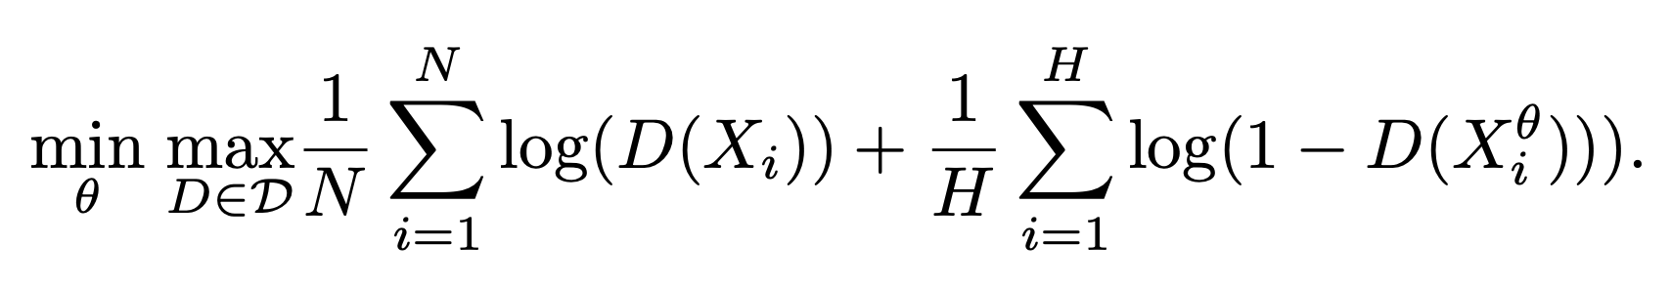
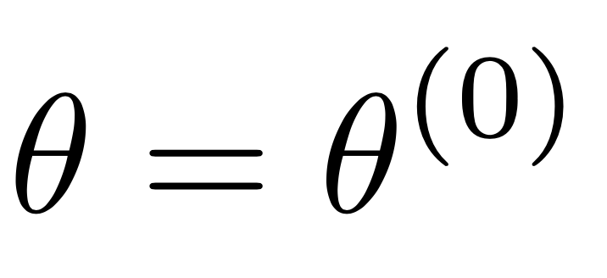
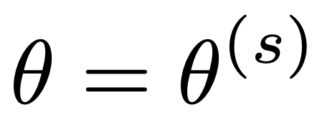
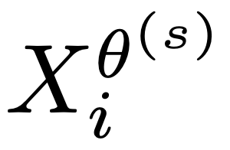
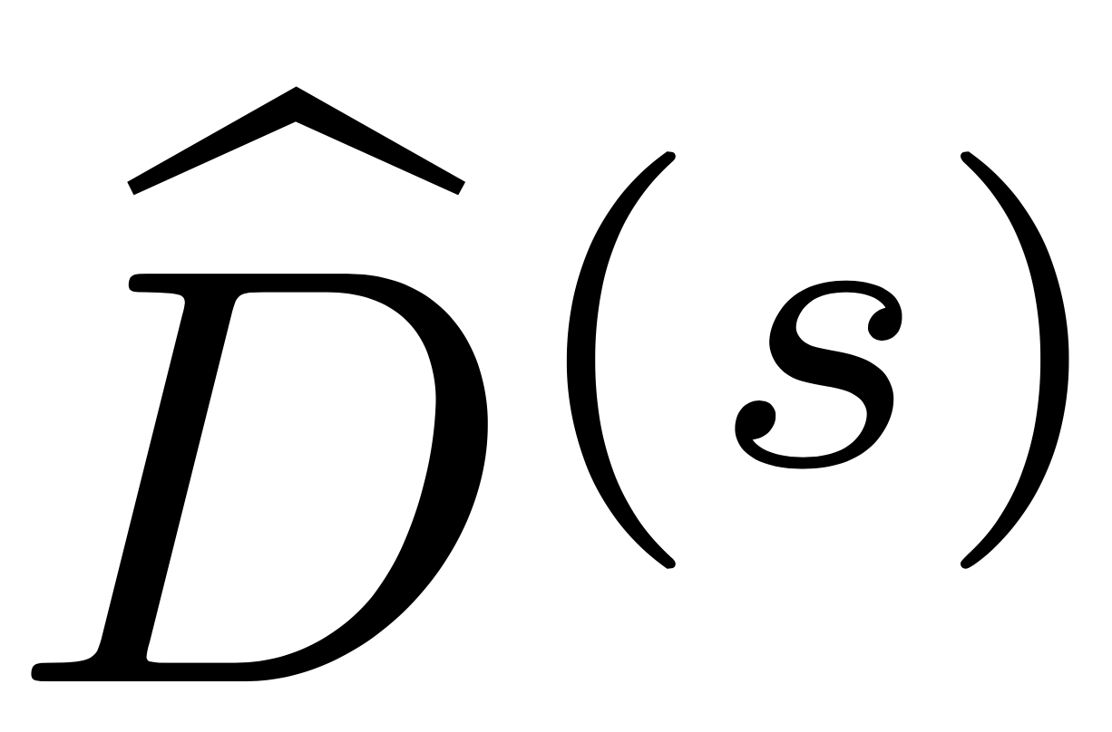
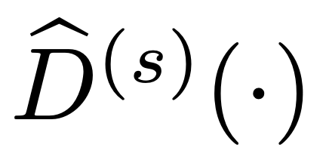
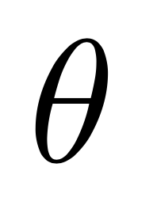
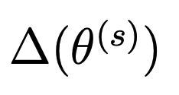
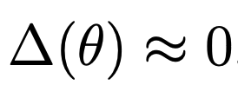
Implementation
“Cross-Entropy Loss”
Real Data
Simulated Data
Start with random initial
For , use our model to obtain
Solve inner maximization to obtain
Given , compute numerical gradients of loss w.r.t.
Repeat until convergence
Simulated Data
NN with 3 hidden layers + sigmoid activation
Notes:
[To implement this, we start with random initial set of theta. With this theta, we tap into our simulation machine to obtain the simulated data. Adding the actual data to the mix, we can then solve the inner maximization to obtain our discriminator. ]
We use a NN with 3 hidden layers. NN is known to perform really well in terms of classification accuracy and it can also turn large data into into lower dimensional problem, which is pretty attractive when we have a structural model with substantial heterogeneity. (large dimensional Xi)
Given this discriminator, we can compute numerical gradients of loss with respect to our parameter. These gradients give us where we should evaluate next. We repeat this process until convergence.
[13 minutes = need to rush!]
Our neural network is specified with a three-unit dense layer followed by a batch normalization and the leakyReLu activation function. We use a dropout rate of 40% between the first and the second block of dense. The dense, batch normalization, leakyReLu, and dropout pattern are repeated for three hidden layers before the last sigmoid output later. These are trained with a batch size of 32. To train the generator network, we use the gradient from the discriminator model to back-propagate through the cost function, and this allows us to calculate the gradient with respect to our parameters at the end of each iteration. Additionally, a soft labeling technique is implemented, to increase the stability of our GAN adaptation. To prevent the discriminator from overfitting, its weights are reinitialized when a gradient explosion occurs. We use the tensorflow and keras packages in R and the default Adam optimization algorithm for our implementation. After we train Dˆ using X and Xθ, we then fit it back to the same inputs to predict the labels Yˆ. We consider a cross-entropy loss function:

Slide 65
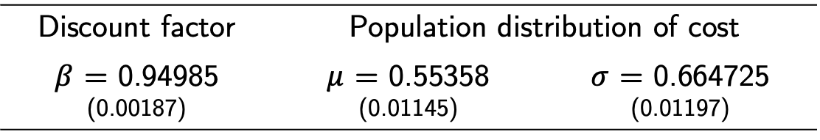
Estimation Results
Discount factor | Population distribution of cost
$β$ = 0.94985 (0.00187) | $μ$ = 0.55358 (0.01145) | $σ$ = 0.664725 (0.01197)
Notes:
Now let’s take a look at our result. The final set of theta includes the discount factor beta which we estimated to be 0.92.
With these estimates, we can then compute the average cost for each individual driver [CLICK] conditional on their decisions we observed. So here is the distribution of the cost.
We observe 2 pretty distinct groups, so I’ll call them as Low-Cost vs High-cost. The mixes of vehicle types are similar, but they differ in the locations they start working for the day.
Via mostly in Manhattan
Get paid to go there using Uber (another platform) -> Downtown/Midtown
Queens – Brooklyn start from home
UWS/LWS coming in from Jersey
UES, Harlem, LES always popular

Slide 66
Estimation Results
Discount factor | Population distribution of cost
$β$ = 0.94985 (0.00187) | $μ$ = 0.55358 (0.01145) | $σ$ = 0.664725 (0.01197)
$1 in 2 hours
→ 73 cents now
Low-cost
High-cost
UWS, LWS, Brooklyn
JFK Airport
Notes:
Now let’s take a look at our result. The final set of theta includes the discount factor beta which we estimated to be 0.92.
With these estimates, we can then compute the average cost for each individual driver [CLICK] conditional on their decisions we observed. So here is the distribution of the cost.
We observe 2 pretty distinct groups, so I’ll call them as Low-Cost vs High-cost. The mixes of vehicle types are similar, but they differ in the locations they start working for the day.
Via mostly in Manhattan
Get paid to go there using Uber (another platform) -> Downtown/Midtown
Queens – Brooklyn start from home
UWS/LWS coming in from Jersey
UES, Harlem, LES always popular

Slide 67
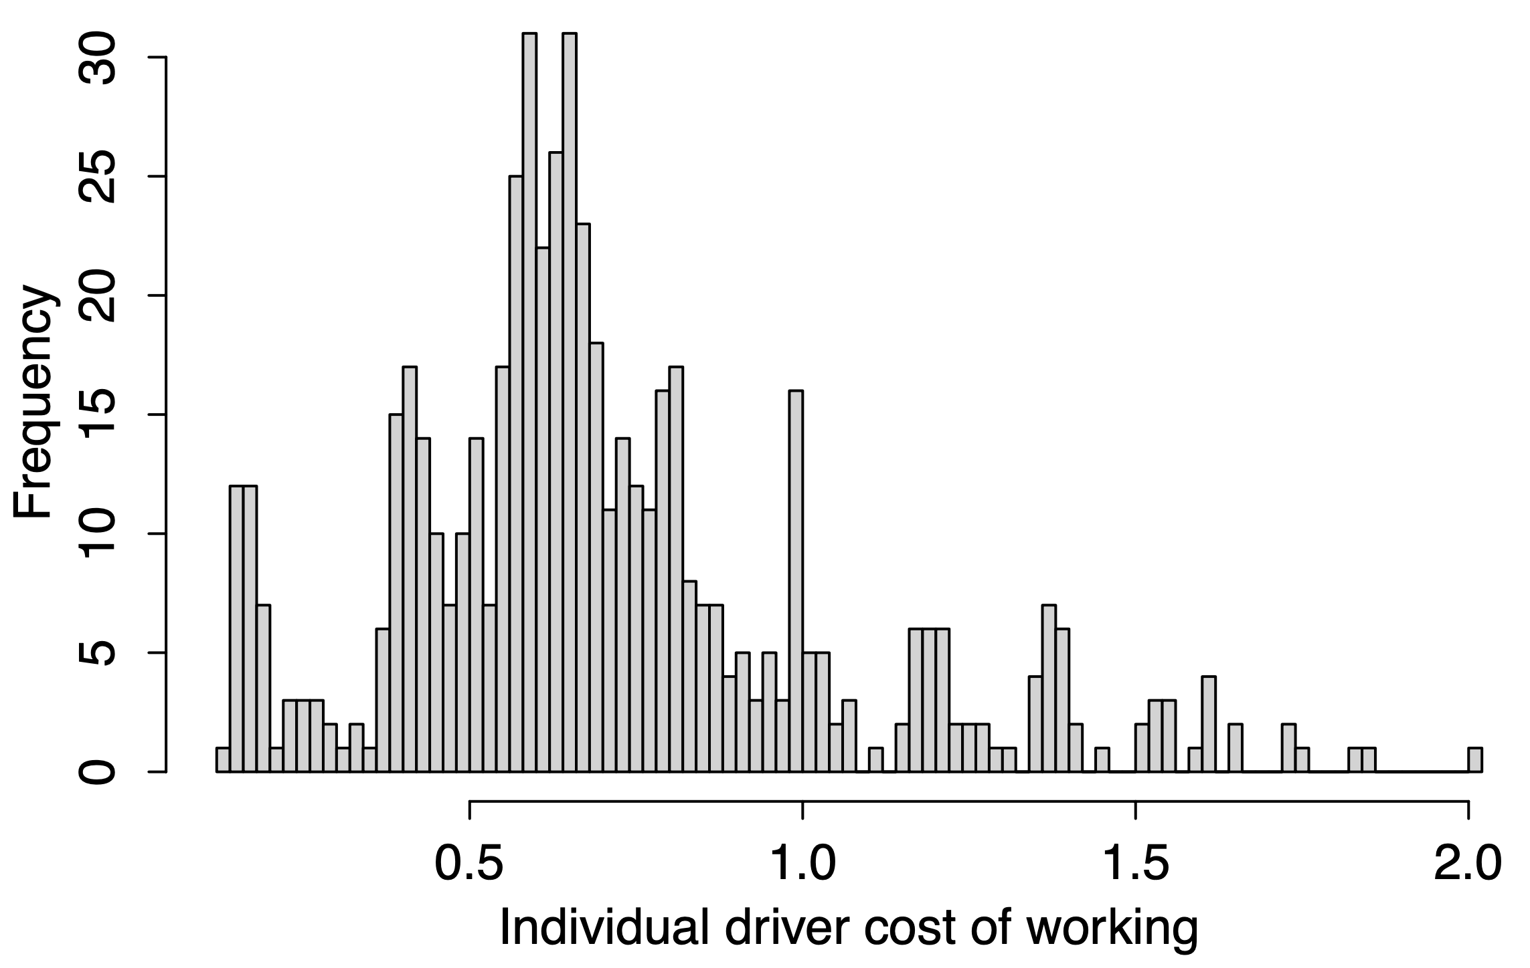
Estimation Results
Discount factor | Population distribution of cost
$β$ = 0.94985 (0.00187) | $μ$ = 0.55358 (0.01145) | $σ$ = 0.664725 (0.01197)
$1 in 2 hours
→ 73 cents now
Low-cost
High-cost
UWS, LWS, Brooklyn
JFK Airport
Notes:
Now let’s take a look at our result. The final set of theta includes the discount factor beta which we estimated to be 0.92.
With these estimates, we can then compute the average cost for each individual driver [CLICK] conditional on their decisions we observed. So here is the distribution of the cost.
We observe 2 pretty distinct groups, so I’ll call them as Low-Cost vs High-cost. The mixes of vehicle types are similar, but they differ in the locations they start working for the day.
Via mostly in Manhattan
Get paid to go there using Uber (another platform) -> Downtown/Midtown
Queens – Brooklyn start from home
UWS/LWS coming in from Jersey
UES, Harlem, LES always popular

Slide 68
Estimation Results
Discount factor | Population distribution of cost
$β$ = 0.94985 (0.00187) | $μ$ = 0.55358 (0.01145) | $σ$ = 0.664725 (0.01197)
66.59% most days
Fraction of workdays multihoming

Slide 69
Estimation Results
Discount factor | Population distribution of cost
$β$ = 0.94985 (0.00187) | $μ$ = 0.55358 (0.01145) | $σ$ = 0.664725 (0.01197)
66.59% most days
16.01% never
Fraction of workdays multihoming
42.23% always

Slide 70
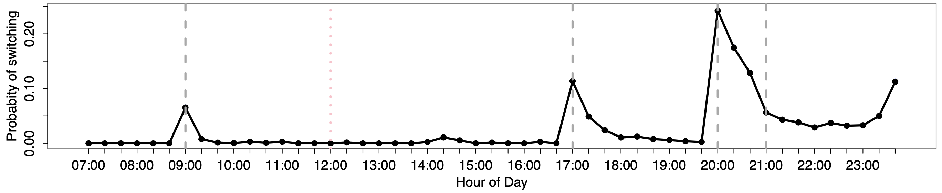
Estimation Results
Discount factor | Population distribution of cost
$β$ = 0.94985 (0.00187) | $μ$ = 0.55358 (0.01145) | $σ$ = 0.664725 (0.01197)
66.59% most days
16.01% never
Fraction of workdays multihoming
42.23% always
P(switching to B) on average weekday
Hourly rate changes
Hourly rate changes
Hourly rate changes
Hourly rate changes

Slide 71
“Drivers strongly prioritize short-term earnings with significant reaction to differences in short-run earnings across platforms.”
How to Control Multihoming?
Notes:
A couple recent theoretical works show that it’s good because workers spend less time idling.
But another found that yes they work more but they also earn less.
It’s also bad for the firm given some cities like NYC, put a cap on the number of drivers. So multihoming means workers spend less fraction of their time working for you.
So here the goal is to Manage/Control multihoming.
[NEXT]

Slide 72
“Drivers strongly prioritize short-term earnings with significant reaction to differences in short-run earnings across platforms.”
How to Control Multihoming?
dynamic pay per work?
Notes:
A couple recent theoretical works show that it’s good because workers spend less time idling.
But another found that yes they work more but they also earn less.
It’s also bad for the firm given some cities like NYC, put a cap on the number of drivers. So multihoming means workers spend less fraction of their time working for you.
So here the goal is to Manage/Control multihoming.
[NEXT]

Slide 73
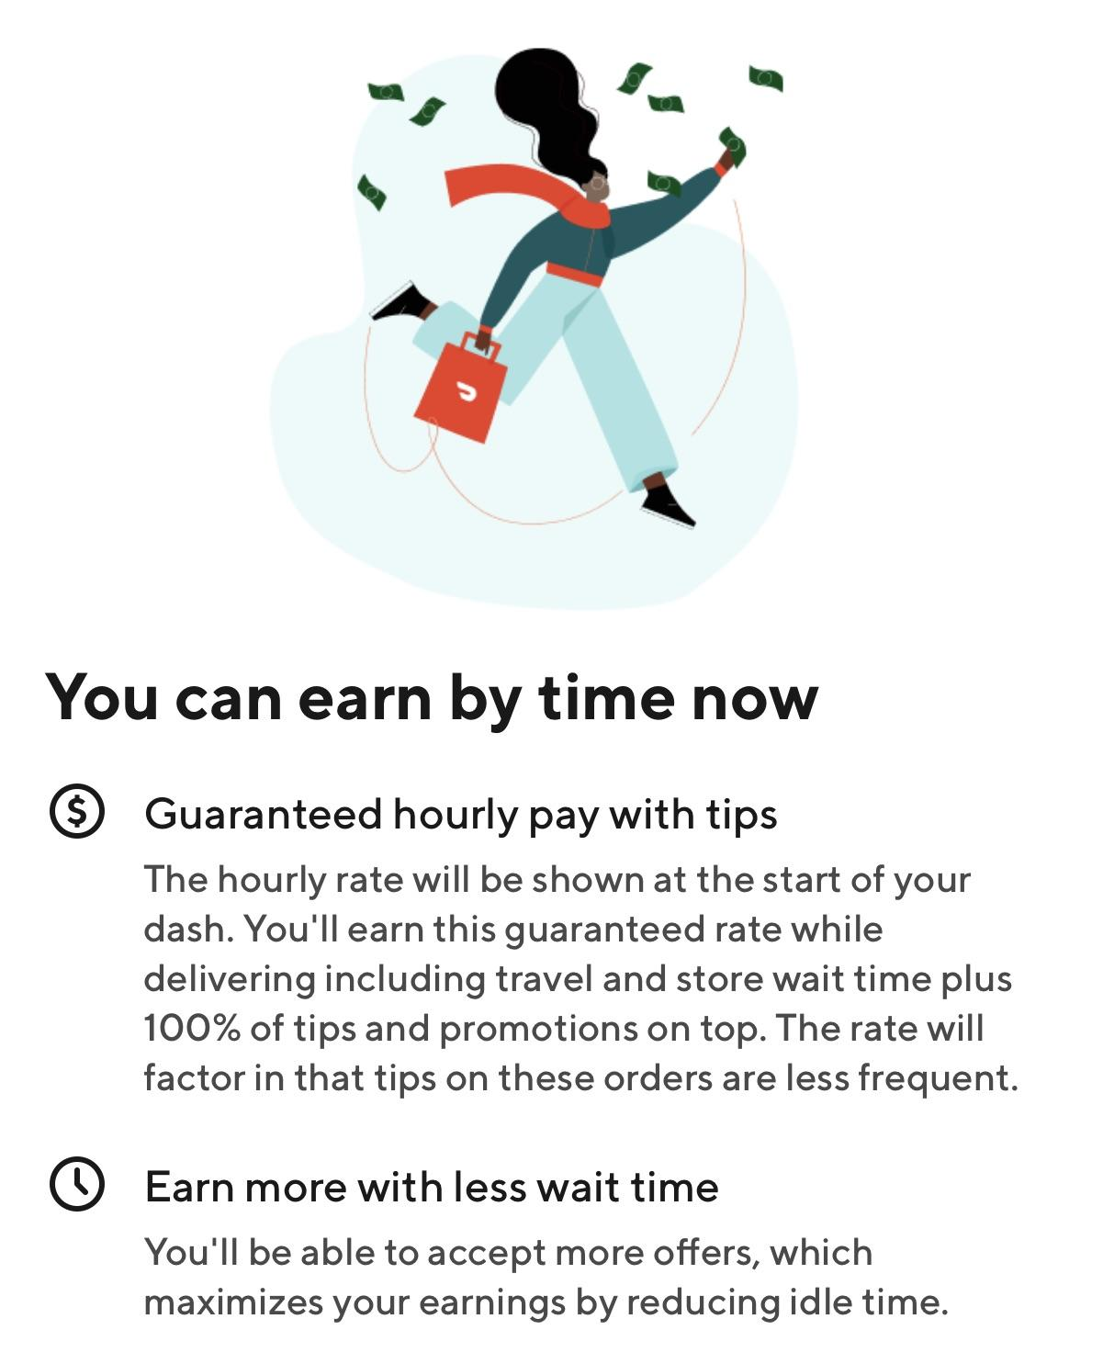
“Drivers strongly prioritize short-term earnings with significant reaction to differences in short-run earnings across platforms.”
How to Control Multihoming?
dynamic pay per work?
dynamic guaranteed pay?
Notes:
A couple recent theoretical works show that it’s good because workers spend less time idling.
But another found that yes they work more but they also earn less.
It’s also bad for the firm given some cities like NYC, put a cap on the number of drivers. So multihoming means workers spend less fraction of their time working for you.
So here the goal is to Manage/Control multihoming.
[NEXT]

Slide 74
“Drivers strongly prioritize short-term earnings with significant reaction to differences in short-run earnings across platforms.”
How to Control Multihoming?
dynamic pay per work?
dynamic guaranteed pay?
Counterfactual #1
which pay is better?
(long-term capacity)
Notes:
A couple recent theoretical works show that it’s good because workers spend less time idling.
But another found that yes they work more but they also earn less.
It’s also bad for the firm given some cities like NYC, put a cap on the number of drivers. So multihoming means workers spend less fraction of their time working for you.
So here the goal is to Manage/Control multihoming.
[NEXT]

Slide 75
“Drivers strongly prioritize short-term earnings with significant reaction to differences in short-run earnings across platforms.”
How to Control Multihoming?
dynamic pay per work?
dynamic guaranteed pay?
Counterfactual #1
which pay is better?
(long-term capacity)
B
A
what happens when the focal firm switches to pay per work?
Notes:
A couple recent theoretical works show that it’s good because workers spend less time idling.
But another found that yes they work more but they also earn less.
It’s also bad for the firm given some cities like NYC, put a cap on the number of drivers. So multihoming means workers spend less fraction of their time working for you.
So here the goal is to Manage/Control multihoming.
[NEXT]

Slide 76
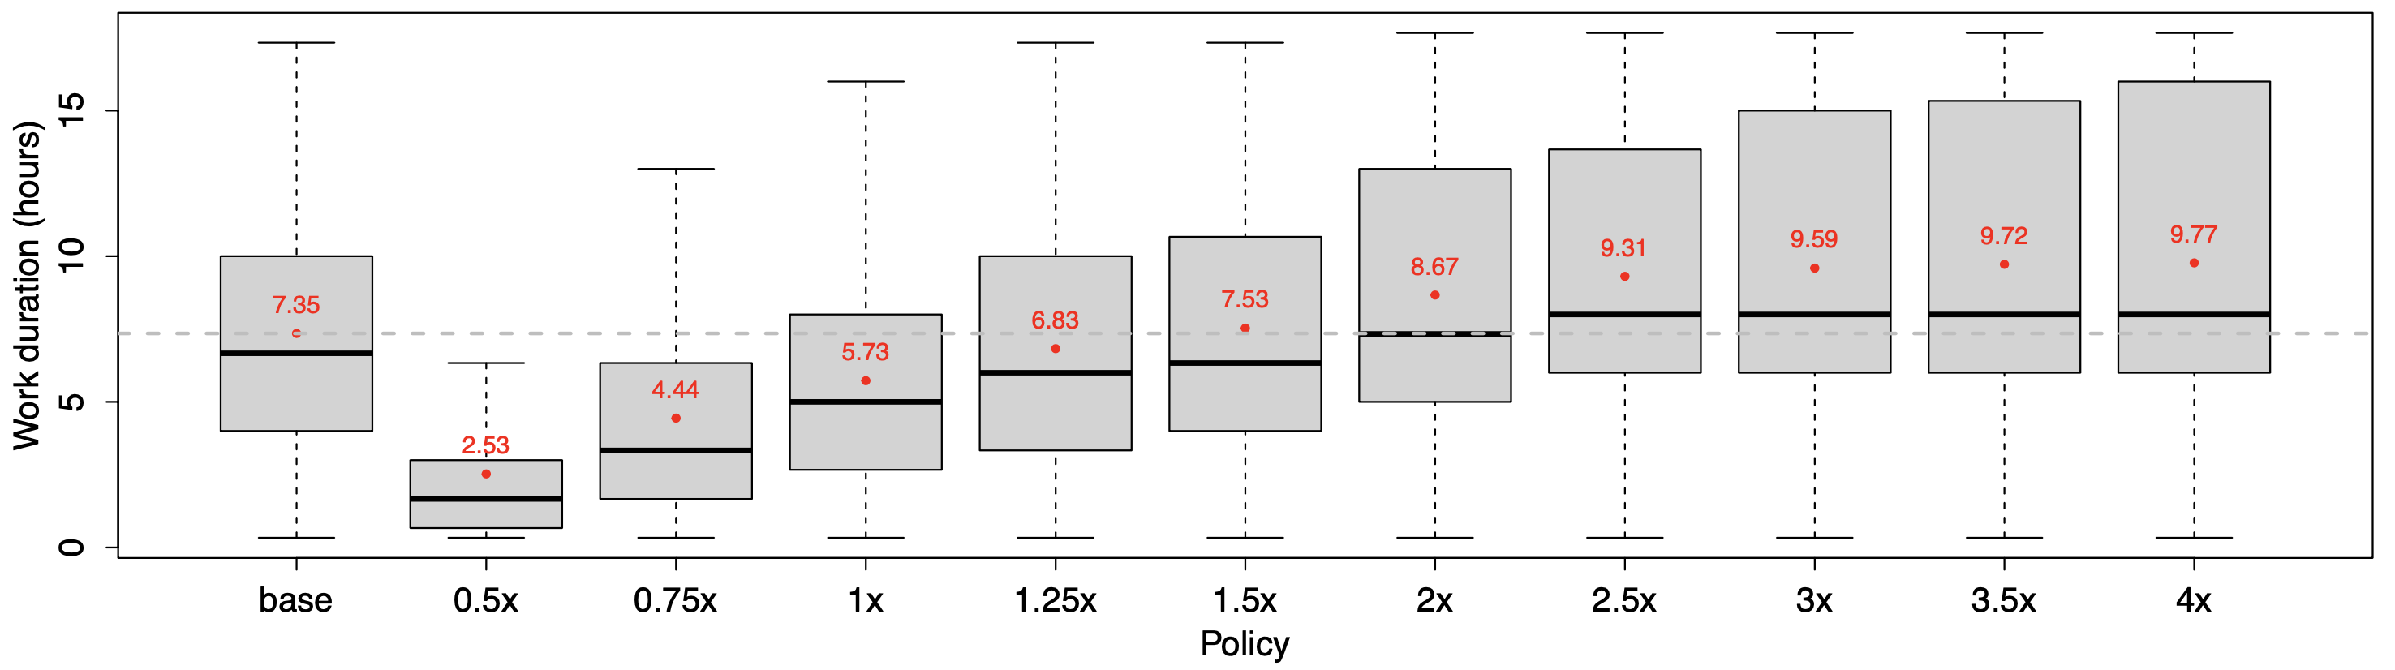
Counterfactual #1
Pay Scheme
Guaranteed Pay
Work Duration (hours)
Pay per Work
Switching from guaranteed pay → pay per work of equivalent rate = reduces work duration
Notes:
Note that the regular pay-per-trip policy (1×) generally leads to a shorter work duration on the focal platform (22.04%). It would require the platform to increase the scaling factor between 1.25× and 1.5× in order to match the work duration under the base policy.
suggests the first benefit of the guaranteed pay: the firm can induce the workers to work for the same duration at a lower cost if the firm guarantees the earnings regardless of the number of trips.
Drivers who never switch to the competing platform when working for the focal firm can be considered as the most loyal group. We find that, to keep the same fraction of these loyal drivers as when offering the guaranteed pay, the pay-per-trip rate has be between 2.5× and 3× of the current hourly offer (see Figure 7a). In other words, a guaranteed pay scheme could save the platform up to 75% of the cost to maintain the same level of loyal drivers pool. Similarly, to keep the same fraction of drivers who switch most of the times, the pay-per-trip rate has to be between 1.5× and 2× (see Figure 7b).

Slide 77
Counterfactual #1
Pay Scheme
Guaranteed Pay
Work Duration (hours)
Pay per Work
Switching from guaranteed pay → pay per work, need 1.25-1.5x rate to match prior work duration
Notes:
Note that the regular pay-per-trip policy (1×) generally leads to a shorter work duration on the focal platform (22.04%). It would require the platform to increase the scaling factor between 1.25× and 1.5× in order to match the work duration under the base policy.
suggests the first benefit of the guaranteed pay: the firm can induce the workers to work for the same duration at a lower cost if the firm guarantees the earnings regardless of the number of trips.
Drivers who never switch to the competing platform when working for the focal firm can be considered as the most loyal group. We find that, to keep the same fraction of these loyal drivers as when offering the guaranteed pay, the pay-per-trip rate has be between 2.5× and 3× of the current hourly offer (see Figure 7a). In other words, a guaranteed pay scheme could save the platform up to 75% of the cost to maintain the same level of loyal drivers pool. Similarly, to keep the same fraction of drivers who switch most of the times, the pay-per-trip rate has to be between 1.5× and 2× (see Figure 7b).

Slide 78
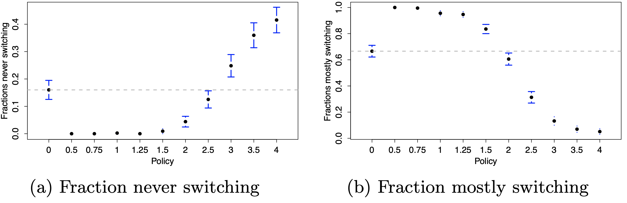
Counterfactual #1
Pay Scheme
Fraction of workers who never switched
Guaranteed Pay
Pay per Work
Base
Notes:
Note that the regular pay-per-trip policy (1×) generally leads to a shorter work duration on the focal platform (22.04%). It would require the platform to increase the scaling factor between 1.25× and 1.5× in order to match the work duration under the base policy.
suggests the first benefit of the guaranteed pay: the firm can induce the workers to work for the same duration at a lower cost if the firm guarantees the earnings regardless of the number of trips.
Drivers who never switch to the competing platform when working for the focal firm can be considered as the most loyal group. We find that, to keep the same fraction of these loyal drivers as when offering the guaranteed pay, the pay-per-trip rate has be between 2.5× and 3× of the current hourly offer (see Figure 7a). In other words, a guaranteed pay scheme could save the platform up to 75% of the cost to maintain the same level of loyal drivers pool. Similarly, to keep the same fraction of drivers who switch most of the times, the pay-per-trip rate has to be between 1.5× and 2× (see Figure 7b).

Slide 79
Counterfactual #1
Pay Scheme
Fraction of workers who never switched
Guaranteed Pay
Pay per Work
Base
Need 2.5-3x rate to keep the most dedicated workers
Notes:
Note that the regular pay-per-trip policy (1×) generally leads to a shorter work duration on the focal platform (22.04%). It would require the platform to increase the scaling factor between 1.25× and 1.5× in order to match the work duration under the base policy.
suggests the first benefit of the guaranteed pay: the firm can induce the workers to work for the same duration at a lower cost if the firm guarantees the earnings regardless of the number of trips.
Drivers who never switch to the competing platform when working for the focal firm can be considered as the most loyal group. We find that, to keep the same fraction of these loyal drivers as when offering the guaranteed pay, the pay-per-trip rate has be between 2.5× and 3× of the current hourly offer (see Figure 7a). In other words, a guaranteed pay scheme could save the platform up to 75% of the cost to maintain the same level of loyal drivers pool. Similarly, to keep the same fraction of drivers who switch most of the times, the pay-per-trip rate has to be between 1.5× and 2× (see Figure 7b).

Slide 80
“Pay is not the only lever that platforms currently use to influence worker behavior”
How to Control Multihoming?
B
A
what happens when the focal firm switches to pay per work?
Notes:
A couple recent theoretical works show that it’s good because workers spend less time idling.
But another found that yes they work more but they also earn less.
It’s also bad for the firm given some cities like NYC, put a cap on the number of drivers. So multihoming means workers spend less fraction of their time working for you.
So here the goal is to Manage/Control multihoming.
[NEXT]

Slide 81
“Pay is not the only lever that platforms currently use to influence worker behavior”
How to Control Multihoming?
Counterfactual #2
impact of incentives to stay longer?
(short-term capacity)
B
A
what happens when the focal firm switches to pay per work?
Notes:
A couple recent theoretical works show that it’s good because workers spend less time idling.
But another found that yes they work more but they also earn less.
It’s also bad for the firm given some cities like NYC, put a cap on the number of drivers. So multihoming means workers spend less fraction of their time working for you.
So here the goal is to Manage/Control multihoming.
[NEXT]

Slide 82
“Pay is not the only lever that platforms currently use to influence worker behavior”
How to Control Multihoming?
Streak Bonus
Counterfactual #2
impact of incentives to stay longer?
(short-term capacity)
B
A
what happens when the focal firm switches to pay per work?
Notes:
A couple recent theoretical works show that it’s good because workers spend less time idling.
But another found that yes they work more but they also earn less.
It’s also bad for the firm given some cities like NYC, put a cap on the number of drivers. So multihoming means workers spend less fraction of their time working for you.
So here the goal is to Manage/Control multihoming.
[NEXT]

Slide 83
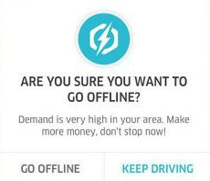
“Pay is not the only lever that platforms currently use to influence worker behavior”
How to Control Multihoming?
Time Delay
Streak Bonus
Counterfactual #2
impact of incentives to stay longer?
(short-term capacity)
B
A
what happens when the focal firm switches to pay per work?
Notes:
A couple recent theoretical works show that it’s good because workers spend less time idling.
But another found that yes they work more but they also earn less.
It’s also bad for the firm given some cities like NYC, put a cap on the number of drivers. So multihoming means workers spend less fraction of their time working for you.
So here the goal is to Manage/Control multihoming.
[NEXT]

Slide 84
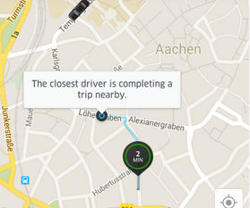
“Pay is not the only lever that platforms currently use to influence worker behavior”
How to Control Multihoming?
Time Delay
Streak Bonus
Counterfactual #2
impact of incentives to stay longer?
(short-term capacity)
B
A
what happens when the focal firm switches to pay per work?
Notes:
A couple recent theoretical works show that it’s good because workers spend less time idling.
But another found that yes they work more but they also earn less.
It’s also bad for the firm given some cities like NYC, put a cap on the number of drivers. So multihoming means workers spend less fraction of their time working for you.
So here the goal is to Manage/Control multihoming.
[NEXT]

Slide 85
Counterfactual #2
Short-Term
Time Delay
Streak Bonus
Notes:
Note that the regular pay-per-trip policy (1×) generally leads to a shorter work duration on the focal platform (22.04%). It would require the platform to increase the scaling factor between 1.25× and 1.5× in order to match the work duration under the base policy.
suggests the first benefit of the guaranteed pay: the firm can induce the workers to work for the same duration at a lower cost if the firm guarantees the earnings regardless of the number of trips.
Drivers who never switch to the competing platform when working for the focal firm can be considered as the most loyal group. We find that, to keep the same fraction of these loyal drivers as when offering the guaranteed pay, the pay-per-trip rate has be between 2.5× and 3× of the current hourly offer (see Figure 7a). In other words, a guaranteed pay scheme could save the platform up to 75% of the cost to maintain the same level of loyal drivers pool. Similarly, to keep the same fraction of drivers who switch most of the times, the pay-per-trip rate has to be between 1.5× and 2× (see Figure 7b).

Slide 86
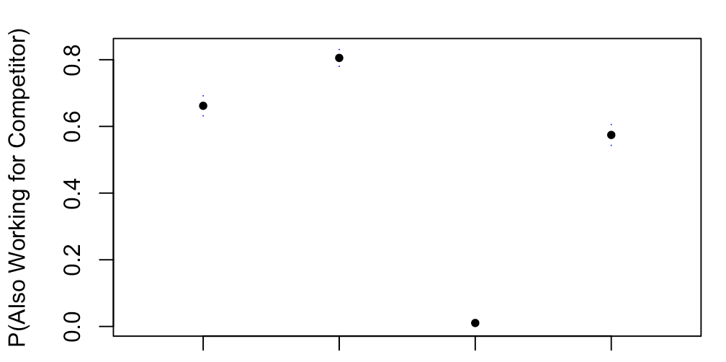
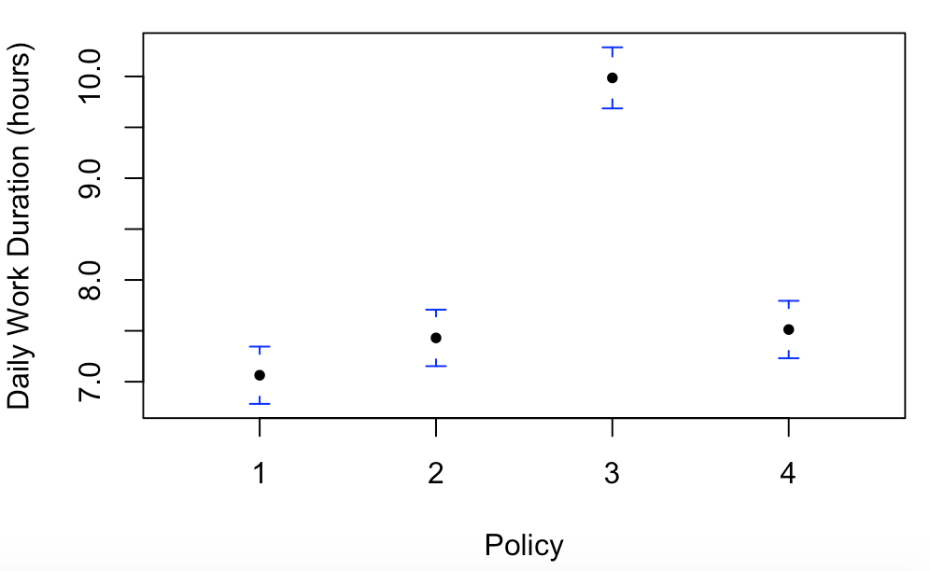
Counterfactual #2
Short-Term
Time Delay
Streak Bonus
Daily Work Duration
P(Multihoming)
Base Delay Streak
Base Delay Streak
Notes:
Note that the regular pay-per-trip policy (1×) generally leads to a shorter work duration on the focal platform (22.04%). It would require the platform to increase the scaling factor between 1.25× and 1.5× in order to match the work duration under the base policy.
suggests the first benefit of the guaranteed pay: the firm can induce the workers to work for the same duration at a lower cost if the firm guarantees the earnings regardless of the number of trips.
Drivers who never switch to the competing platform when working for the focal firm can be considered as the most loyal group. We find that, to keep the same fraction of these loyal drivers as when offering the guaranteed pay, the pay-per-trip rate has be between 2.5× and 3× of the current hourly offer (see Figure 7a). In other words, a guaranteed pay scheme could save the platform up to 75% of the cost to maintain the same level of loyal drivers pool. Similarly, to keep the same fraction of drivers who switch most of the times, the pay-per-trip rate has to be between 1.5× and 2× (see Figure 7b).

Slide 87
Counterfactual #2
Short-Term
Time Delay
Streak Bonus
Daily Work Duration
P(Multihoming)
Base Delay Streak
Base Delay Streak
Notes:
Note that the regular pay-per-trip policy (1×) generally leads to a shorter work duration on the focal platform (22.04%). It would require the platform to increase the scaling factor between 1.25× and 1.5× in order to match the work duration under the base policy.
suggests the first benefit of the guaranteed pay: the firm can induce the workers to work for the same duration at a lower cost if the firm guarantees the earnings regardless of the number of trips.
Drivers who never switch to the competing platform when working for the focal firm can be considered as the most loyal group. We find that, to keep the same fraction of these loyal drivers as when offering the guaranteed pay, the pay-per-trip rate has be between 2.5× and 3× of the current hourly offer (see Figure 7a). In other words, a guaranteed pay scheme could save the platform up to 75% of the cost to maintain the same level of loyal drivers pool. Similarly, to keep the same fraction of drivers who switch most of the times, the pay-per-trip rate has to be between 1.5× and 2× (see Figure 7b).

Slide 88
Counterfactual #2
Short-Term
Time Delay
Streak Bonus
Daily Work Duration
P(Multihoming)
Base Delay Streak
Base Delay Streak
Notes:
Note that the regular pay-per-trip policy (1×) generally leads to a shorter work duration on the focal platform (22.04%). It would require the platform to increase the scaling factor between 1.25× and 1.5× in order to match the work duration under the base policy.
suggests the first benefit of the guaranteed pay: the firm can induce the workers to work for the same duration at a lower cost if the firm guarantees the earnings regardless of the number of trips.
Drivers who never switch to the competing platform when working for the focal firm can be considered as the most loyal group. We find that, to keep the same fraction of these loyal drivers as when offering the guaranteed pay, the pay-per-trip rate has be between 2.5× and 3× of the current hourly offer (see Figure 7a). In other words, a guaranteed pay scheme could save the platform up to 75% of the cost to maintain the same level of loyal drivers pool. Similarly, to keep the same fraction of drivers who switch most of the times, the pay-per-trip rate has to be between 1.5× and 2× (see Figure 7b).

Slide 89
Counterfactual #2
Short-Term
Time Delay
Streak Bonus
Daily Work Duration
P(Multihoming)
Base Delay Streak
Base Delay Streak
Good for low demand
Good for peak hours
Notes:
Note that the regular pay-per-trip policy (1×) generally leads to a shorter work duration on the focal platform (22.04%). It would require the platform to increase the scaling factor between 1.25× and 1.5× in order to match the work duration under the base policy.
suggests the first benefit of the guaranteed pay: the firm can induce the workers to work for the same duration at a lower cost if the firm guarantees the earnings regardless of the number of trips.
Drivers who never switch to the competing platform when working for the focal firm can be considered as the most loyal group. We find that, to keep the same fraction of these loyal drivers as when offering the guaranteed pay, the pay-per-trip rate has be between 2.5× and 3× of the current hourly offer (see Figure 7a). In other words, a guaranteed pay scheme could save the platform up to 75% of the cost to maintain the same level of loyal drivers pool. Similarly, to keep the same fraction of drivers who switch most of the times, the pay-per-trip rate has to be between 1.5× and 2× (see Figure 7b).

Slide 90
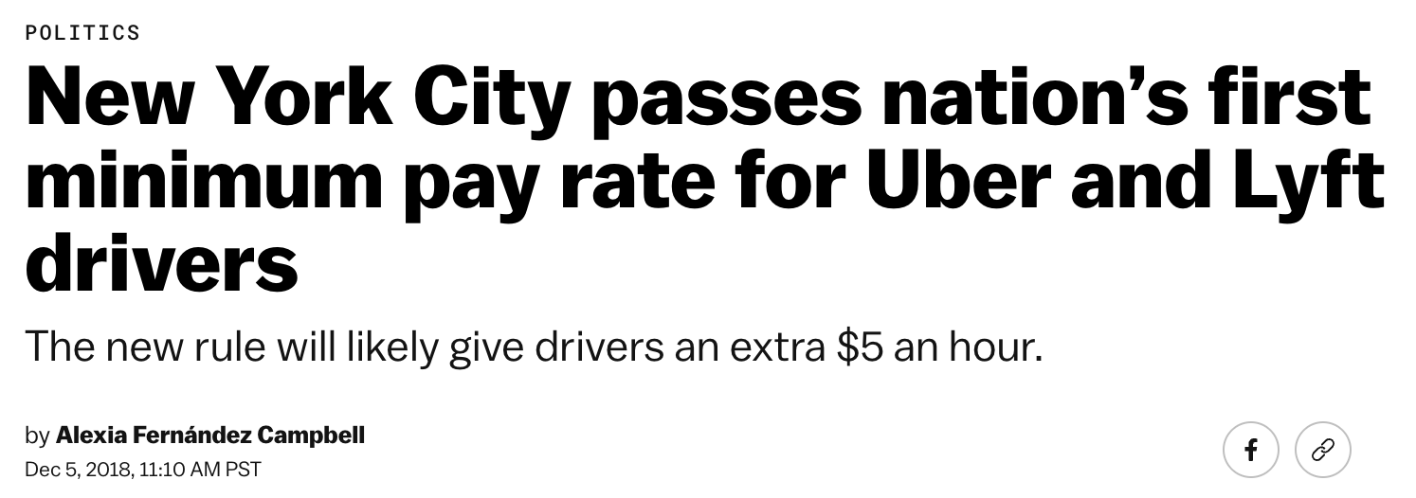

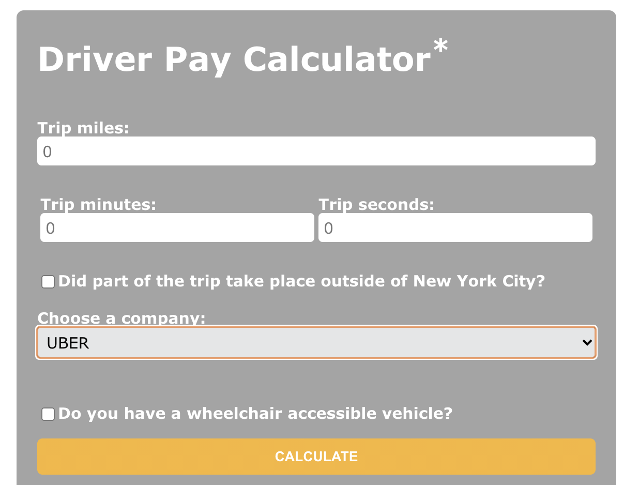
Overall, drivers should earn $17.22+ per hour of working
Must be paid at least ($1.088 x miles + $0.495 x minutes)/trip
Notes:
Before, it’s $11.90/hour after expenses (NYC minimum wage was $13)
Our model is missing the fact that this will raise the price of service -> lower demand -> utilization level changes
Varying utilization.
Starting in February, ride-share companies have to reduce cruising rates by 5% and later by 10%, down from currently 41%.
Uber supported a $2.75 congestion surcharge implemented for Manhattan ride-share trips earlier this year.
Firms’ responses: Uber and Lyft restricted access (lock drivers out during some times / locations), Juno quitted.
Lyft “allow certain companies to pay drivers lower wages” “disincentive drivers from giving rides to and from areas outside NYC” “fewer rides, shorter and slower trips”
Uber “higher than necessary fares”
Feasible for loose labor market. If M is too high, firm will cap its supply. (Aradpour, Lobel, van Ryzin 2020)
From our prelim results, these results suggest that…
Use reduced form as a baseline. Spatial element. Heterogeneity in people.
Targeted different for different things.
Which policies work for which group?
Which locations?
SHOW THESE RESULTS WITH SPATIAL ELEMENTS

Slide 91
Overall, drivers should earn $17.22+ per hour of working
Must be paid at least ($1.088 x miles + $0.495 x minutes)/trip
For 2019, only applied to pay-per-work platforms
Notes:
Before, it’s $11.90/hour after expenses (NYC minimum wage was $13)
Our model is missing the fact that this will raise the price of service -> lower demand -> utilization level changes
Varying utilization.
Starting in February, ride-share companies have to reduce cruising rates by 5% and later by 10%, down from currently 41%.
Uber supported a $2.75 congestion surcharge implemented for Manhattan ride-share trips earlier this year.
Firms’ responses: Uber and Lyft restricted access (lock drivers out during some times / locations), Juno quitted.
Lyft “allow certain companies to pay drivers lower wages” “disincentive drivers from giving rides to and from areas outside NYC” “fewer rides, shorter and slower trips”
Uber “higher than necessary fares”
Feasible for loose labor market. If M is too high, firm will cap its supply. (Aradpour, Lobel, van Ryzin 2020)
From our prelim results, these results suggest that…
Use reduced form as a baseline. Spatial element. Heterogeneity in people.
Targeted different for different things.
Which policies work for which group?
Which locations?
SHOW THESE RESULTS WITH SPATIAL ELEMENTS

Slide 92
Overall, drivers should earn $17.22+ per hour of working
Must be paid at least ($1.088 x miles + $0.495 x minutes)/trip
For 2019, only applied to pay-per-work platforms
Notes:
Before, it’s $11.90/hour after expenses (NYC minimum wage was $13)
Our model is missing the fact that this will raise the price of service -> lower demand -> utilization level changes
Varying utilization.
Starting in February, ride-share companies have to reduce cruising rates by 5% and later by 10%, down from currently 41%.
Uber supported a $2.75 congestion surcharge implemented for Manhattan ride-share trips earlier this year.
Firms’ responses: Uber and Lyft restricted access (lock drivers out during some times / locations), Juno quitted.
Lyft “allow certain companies to pay drivers lower wages” “disincentive drivers from giving rides to and from areas outside NYC” “fewer rides, shorter and slower trips”
Uber “higher than necessary fares”
Feasible for loose labor market. If M is too high, firm will cap its supply. (Aradpour, Lobel, van Ryzin 2020)
From our prelim results, these results suggest that…
Use reduced form as a baseline. Spatial element. Heterogeneity in people.
Targeted different for different things.
Which policies work for which group?
Which locations?
SHOW THESE RESULTS WITH SPATIAL ELEMENTS

Slide 93
Overall, drivers should earn $17.22+ per hour of working
Must be paid at least ($1.088 x miles + $0.495 x minutes)/trip
Counterfactual #3
Policy Analysis
What happens when the rule is applied universally?
Notes:
Before, it’s $11.90/hour after expenses (NYC minimum wage was $13)
Our model is missing the fact that this will raise the price of service -> lower demand -> utilization level changes
Varying utilization.
Starting in February, ride-share companies have to reduce cruising rates by 5% and later by 10%, down from currently 41%.
Uber supported a $2.75 congestion surcharge implemented for Manhattan ride-share trips earlier this year.
Firms’ responses: Uber and Lyft restricted access (lock drivers out during some times / locations), Juno quitted.
Lyft “allow certain companies to pay drivers lower wages” “disincentive drivers from giving rides to and from areas outside NYC” “fewer rides, shorter and slower trips”
Uber “higher than necessary fares”
Feasible for loose labor market. If M is too high, firm will cap its supply. (Aradpour, Lobel, van Ryzin 2020)
From our prelim results, these results suggest that…
Use reduced form as a baseline. Spatial element. Heterogeneity in people.
Targeted different for different things.
Which policies work for which group?
Which locations?
SHOW THESE RESULTS WITH SPATIAL ELEMENTS

Slide 94
Policy Analysis
Driver Income Rules
Pay-per-work firm adopting the rules?
No
Yes
No
Guaranteed-pay firm adopting the rules?
“Pre-2019”
“Current”
-13.5% switch
-16.8% switch
Notes:
From our prelim results, these results suggest that…
Use reduced form as a baseline. Spatial element. Heterogeneity in people.
Targeted different for different things.
Which policies work for which group?
Which locations?
SHOW THESE RESULTS WITH SPATIAL ELEMENTS

Slide 95
Policy Analysis
Driver Income Rules
Pay-per-work firm adopting the rules?
No
Yes
-3.5% $
+2.1% Idle
No
Guaranteed-pay firm adopting the rules?
“Pre-2019”
“Current”
-13.5% switch
-16.8% switch
Notes:
From our prelim results, these results suggest that…
Use reduced form as a baseline. Spatial element. Heterogeneity in people.
Targeted different for different things.
Which policies work for which group?
Which locations?
SHOW THESE RESULTS WITH SPATIAL ELEMENTS

Slide 96
Policy Analysis
Driver Income Rules
Pay-per-work firm adopting the rules?
No
Yes
Drivers: “Not really. Too many drivers. Too much idle time.”
Fares not necessarily higher (Parrott, Reich 2018)
-3.5% $
+2.1% Idle
No
Guaranteed-pay firm adopting the rules?
“Pre-2019”
“Current”
-13.5% switch
-16.8% switch
Notes:
From our prelim results, these results suggest that…
Use reduced form as a baseline. Spatial element. Heterogeneity in people.
Targeted different for different things.
Which policies work for which group?
Which locations?
SHOW THESE RESULTS WITH SPATIAL ELEMENTS

Slide 97
Policy Analysis
Driver Income Rules
Pay-per-work firm adopting the rules?
No
Yes
-3.5% $
+2.1% Idle
No
Guaranteed-pay firm adopting the rules?
“Pre-2019”
“Current”
“Reverse”
Yes
+3% $
+3.3% Idle
-13.5% switch
-16.8% switch
Notes:
From our prelim results, these results suggest that…
Use reduced form as a baseline. Spatial element. Heterogeneity in people.
Targeted different for different things.
Which policies work for which group?
Which locations?
SHOW THESE RESULTS WITH SPATIAL ELEMENTS

Slide 98
Policy Analysis
Driver Income Rules
Pay-per-work firm adopting the rules?
No
Yes
-3.5% $
+2.1% Idle
No
Guaranteed-pay firm adopting the rules?
“Pre-2019”
“Current”
“Reverse”
“Universal”
Yes
+3% $
-1.2% $
+3.3% Idle
+7% Idle
-13.5% switch
-16.8% switch
Notes:
From our prelim results, these results suggest that…
Use reduced form as a baseline. Spatial element. Heterogeneity in people.
Targeted different for different things.
Which policies work for which group?
Which locations?
SHOW THESE RESULTS WITH SPATIAL ELEMENTS

Slide 99
Policy Analysis
Driver Income Rules
Pay-per-work firm adopting the rules?
No
Yes
-3.5% $
+2.1% Idle
No
Guaranteed-pay firm adopting the rules?
“Pre-2019”
“Current”
“Reverse”
“Universal”
Yes
+3% $
-1.2% $
+3.3% Idle
+7% Idle
-13.5% switch
-16.8% switch
Notes:
From our prelim results, these results suggest that…
Use reduced form as a baseline. Spatial element. Heterogeneity in people.
Targeted different for different things.
Which policies work for which group?
Which locations?
SHOW THESE RESULTS WITH SPATIAL ELEMENTS

Slide 100

Summary
Structural modeling of gig workers’ multihoming decisions
Insights
ML/GAN-based adversarial estimation (historically hard to trace)
42% of drivers always multihome, 2/3 on most days
Drivers are strongly myopic; responding to short-term incentives
Guaranteed pay: save 25-50% from pay-per-work
Peak hours: streak bonus to retain drivers
Low demand: time delay to nudge earlier departure
Our model helps predict impact of policy
Thank you!
Next Steps
Extend to N outside work options
Allow for switching back and forth
Allow for non-zero time-dependent “home” option
Link back to income targeting and inertia
Read more:
bit.ly/ mmwpaper
Gad Allon, Maxime Cohen, Ken Moon, Park Sinchaisri (parksinchaisri@berkeley.edu)
Notes:
To summarize, understanding how workers make multihoming decisions is important for both the firm and the policymakers to design a better policy for all, but it's been hard to trace and study. We're hoping to close this gap by modeling workers’ sequential intra-day decisions structurally using machine learning and simulation-assisted estimation. Our model accounts for the detailed time and location of drivers’ decisions, the platform’s pay incentives, and the contemporaneous work conditions and compensation rates on the competing gig platform. Our prescriptive counterfactual analyses offer some new insights that could inform the gig platforms’ and policymakers.

Slide 101
Overall, drivers should earn $17.22+ per hour of working
Must be paid at least ($1.088 x miles + $0.495 x minutes)/trip
Counterfactual #3
Policy Analysis
Overall, drivers should earn $17.22+ per hour of working
Must be paid at least ($1.088 x miles + $0.495 x minutes)/trip
Notes:
Before, it’s $11.90/hour after expenses (NYC minimum wage was $13)
Our model is missing the fact that this will raise the price of service -> lower demand -> utilization level changes
Varying utilization.
Starting in February, ride-share companies have to reduce cruising rates by 5% and later by 10%, down from currently 41%.
Uber supported a $2.75 congestion surcharge implemented for Manhattan ride-share trips earlier this year.
Firms’ responses: Uber and Lyft restricted access (lock drivers out during some times / locations), Juno quitted.
Lyft “allow certain companies to pay drivers lower wages” “disincentive drivers from giving rides to and from areas outside NYC” “fewer rides, shorter and slower trips”
Uber “higher than necessary fares”
Feasible for loose labor market. If M is too high, firm will cap its supply. (Aradpour, Lobel, van Ryzin 2020)
From our prelim results, these results suggest that…
Use reduced form as a baseline. Spatial element. Heterogeneity in people.
Targeted different for different things.
Which policies work for which group?
Which locations?
SHOW THESE RESULTS WITH SPATIAL ELEMENTS

Slide 102
Overall, drivers should earn $17.22+ per hour of working
Must be paid at least ($1.088 x miles + $0.495 x minutes)/trip
Counterfactual #3
Policy Analysis
Overall, drivers should earn $17.22+ per hour of working
Must be paid at least ($1.088 x miles + $0.495 x minutes)/trip
Notes:
Before, it’s $11.90/hour after expenses (NYC minimum wage was $13)
Our model is missing the fact that this will raise the price of service -> lower demand -> utilization level changes
Varying utilization.
Starting in February, ride-share companies have to reduce cruising rates by 5% and later by 10%, down from currently 41%.
Uber supported a $2.75 congestion surcharge implemented for Manhattan ride-share trips earlier this year.
Firms’ responses: Uber and Lyft restricted access (lock drivers out during some times / locations), Juno quitted.
Lyft “allow certain companies to pay drivers lower wages” “disincentive drivers from giving rides to and from areas outside NYC” “fewer rides, shorter and slower trips”
Uber “higher than necessary fares”
Feasible for loose labor market. If M is too high, firm will cap its supply. (Aradpour, Lobel, van Ryzin 2020)
From our prelim results, these results suggest that…
Use reduced form as a baseline. Spatial element. Heterogeneity in people.
Targeted different for different things.
Which policies work for which group?
Which locations?
SHOW THESE RESULTS WITH SPATIAL ELEMENTS

Slide 103
Overall, drivers should earn $17.22+ per hour of working
Must be paid at least ($1.088 x miles + $0.495 x minutes)/trip
Counterfactual #3
Policy Analysis
Drivers: “Not really. Too many drivers. Too much idle time.”
Fares not necessarily higher (3-5%) (Parrott, Reich 2018)
-3.5% $
+2.1% Idle
Before
After
Notes:
Before, it’s $11.90/hour after expenses (NYC minimum wage was $13)
Our model is missing the fact that this will raise the price of service -> lower demand -> utilization level changes
Varying utilization.
Starting in February, ride-share companies have to reduce cruising rates by 5% and later by 10%, down from currently 41%.
Uber supported a $2.75 congestion surcharge implemented for Manhattan ride-share trips earlier this year.
Firms’ responses: Uber and Lyft restricted access (lock drivers out during some times / locations), Juno quitted.
Lyft “allow certain companies to pay drivers lower wages” “disincentive drivers from giving rides to and from areas outside NYC” “fewer rides, shorter and slower trips”
Uber “higher than necessary fares”
Feasible for loose labor market. If M is too high, firm will cap its supply. (Aradpour, Lobel, van Ryzin 2020)
From our prelim results, these results suggest that…
Use reduced form as a baseline. Spatial element. Heterogeneity in people.
Targeted different for different things.
Which policies work for which group?
Which locations?
SHOW THESE RESULTS WITH SPATIAL ELEMENTS

Slide 104
1
2
3
sum
Policy Analysis
Driver Income Rules
In December 2018, TLC launched new rules
Overall, drivers should earn $17.22+ per hour of working
Must be paid at least ($1.088 x miles + $0.495 x minutes)/trip
Notes:
Before, it’s $11.90/hour after expenses (NYC minimum wage was $13)
Our model is missing the fact that this will raise the price of service -> lower demand -> utilization level changes
Varying utilization.
Starting in February, ride-share companies have to reduce cruising rates by 5% and later by 10%, down from currently 41%.
Uber supported a $2.75 congestion surcharge implemented for Manhattan ride-share trips earlier this year.
Firms’ responses: Uber and Lyft restricted access (lock drivers out during some times / locations), Juno quitted.
Lyft “allow certain companies to pay drivers lower wages” “disincentive drivers from giving rides to and from areas outside NYC” “fewer rides, shorter and slower trips”
Uber “higher than necessary fares”
Feasible for loose labor market. If M is too high, firm will cap its supply. (Aradpour, Lobel, van Ryzin 2020)
From our prelim results, these results suggest that…
Use reduced form as a baseline. Spatial element. Heterogeneity in people.
Targeted different for different things.
Which policies work for which group?
Which locations?
SHOW THESE RESULTS WITH SPATIAL ELEMENTS

Slide 105
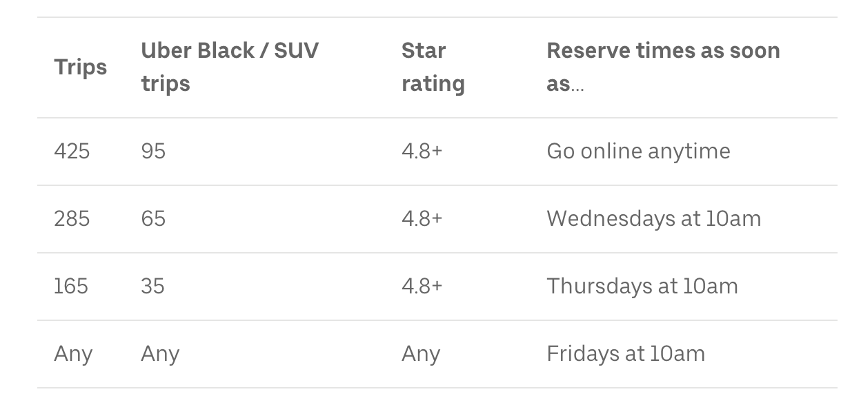
1
2
3
sum
Policy Analysis
Driver Income Rules
In December 2018, TLC launched new rules
Overall, drivers should earn $17.22+ per hour of working
Must be paid at least ($1.088 x miles + $0.495 x minutes)/trip
Uber and Lyft restricted access to some drivers.
Dynamic supply control needed to achieve high min wage (Aradpour, Lobel, van Ryzin 2020)
https://www.uber.com/blog/new-york-city/tlc-rule-changes/
Notes:
Our model is missing the fact that this will raise the price of service -> lower demand -> utilization level changes
Varying utilization.
Starting in February, ride-share companies have to reduce cruising rates by 5% and later by 10%, down from currently 41%.
Uber supported a $2.75 congestion surcharge implemented for Manhattan ride-share trips earlier this year.
Firms’ responses: Uber and Lyft restricted access (lock drivers out during some times / locations), Juno quitted.
Lyft “allow certain companies to pay drivers lower wages” “disincentive drivers from giving rides to and from areas outside NYC” “fewer rides, shorter and slower trips”
Uber “higher than necessary fares”
Feasible for loose labor market. If M is too high, firm will cap its supply. (Aradpour, Lobel, van Ryzin 2020)
From our prelim results, these results suggest that…
Use reduced form as a baseline. Spatial element. Heterogeneity in people.
Targeted different for different things.
Which policies work for which group?
Which locations?
SHOW THESE RESULTS WITH SPATIAL ELEMENTS

Slide 106
1
2
3
sum
Policy Analysis
Driver Income Rules
In December 2018, TLC launched new rules
Overall, drivers should earn $17.22+ per hour of working
Must be paid at least ($1.088 x miles + $0.495 x minutes)/trip
Uber and Lyft restricted access to some drivers.
Dynamic supply control needed to achieve high min wage (Aradpour, Lobel, van Ryzin 2020)
NYC: “Drivers expected to be paid extra $172 million first 4 months”
Drivers: “Not really. Too many drivers. Too much idle time.”
Fares not necessarily higher (3-5%) (Parrott, Reich 2018)
Notes:
Our model is missing the fact that this will raise the price of service -> lower demand -> utilization level changes
Varying utilization.
Starting in February, ride-share companies have to reduce cruising rates by 5% and later by 10%, down from currently 41%.
Uber supported a $2.75 congestion surcharge implemented for Manhattan ride-share trips earlier this year.
Firms’ responses: Uber and Lyft restricted access (lock drivers out during some times / locations), Juno quitted.
Lyft “allow certain companies to pay drivers lower wages” “disincentive drivers from giving rides to and from areas outside NYC” “fewer rides, shorter and slower trips”
Uber “higher than necessary fares”
Feasible for loose labor market. If M is too high, firm will cap its supply. (Aradpour, Lobel, van Ryzin 2020)
From our prelim results, these results suggest that…
Use reduced form as a baseline. Spatial element. Heterogeneity in people.
Targeted different for different things.
Which policies work for which group?
Which locations?
SHOW THESE RESULTS WITH SPATIAL ELEMENTS

Slide 107
1
2
3
sum
Policy Analysis
Driver Income Rules
Competitor adopting the rules?
No
No
Focal firm adopting the rules? (for their hourly-paid drivers)
“Pre-2019”
-13.5% switch
-16.8% switch
Notes:
From our prelim results, these results suggest that…
Use reduced form as a baseline. Spatial element. Heterogeneity in people.
Targeted different for different things.
Which policies work for which group?
Which locations?
SHOW THESE RESULTS WITH SPATIAL ELEMENTS

Slide 108
1
2
3
sum
Policy Analysis
Driver Income Rules
Competitor adopting the rules?
No
Yes
-3.5% $
+2.1% Idle
No
Focal firm adopting the rules? (for their hourly-paid drivers)
“Pre-2019”
“Current”
-13.5% switch
-16.8% switch
Notes:
From our prelim results, these results suggest that…
Use reduced form as a baseline. Spatial element. Heterogeneity in people.
Targeted different for different things.
Which policies work for which group?
Which locations?
SHOW THESE RESULTS WITH SPATIAL ELEMENTS

Slide 109
1
2
3
sum
Policy Analysis
Driver Income Rules
Competitor adopting the rules?
No
Yes
Drivers: “Not really. Too many drivers. Too much idle time.”
Fares not necessarily higher (3-5%) (Parrott, Reich 2018)
-3.5% $
+2.1% Idle
No
Focal firm adopting the rules? (for their hourly-paid drivers)
“Pre-2019”
“Current”
-13.5% switch
-16.8% switch
Notes:
From our prelim results, these results suggest that…
Use reduced form as a baseline. Spatial element. Heterogeneity in people.
Targeted different for different things.
Which policies work for which group?
Which locations?
SHOW THESE RESULTS WITH SPATIAL ELEMENTS

Slide 110
1
2
3
sum
Policy Analysis
Driver Income Rules
Competitor adopting the rules?
No
Yes
Drivers: “Not really. Too many drivers. Too much idle time.”
Fares not necessarily higher (3-5%) (Parrott, Reich 2018)
-3.5% $
+2.1% Idle
No
Focal firm adopting the rules? (for their hourly-paid drivers)
“Pre-2019”
“Current”
“Reverse”
“Universal”
Yes
+3% $
-1.2% $
+3.3% Idle
+7% Idle
-13.5% switch
-16.8% switch
Notes:
From our prelim results, these results suggest that…
Use reduced form as a baseline. Spatial element. Heterogeneity in people.
Targeted different for different things.
Which policies work for which group?
Which locations?
SHOW THESE RESULTS WITH SPATIAL ELEMENTS

Slide 111
1
2
3
sum
Policy Analysis
Driver Income Rules
Competitor adopting the rules?
No
Yes
Drivers: “Not really. Too many drivers. Too much idle time.”
Fares not necessarily higher (3-5%) (Parrott, Reich 2018)
-3.5% $
+2.1% Idle
No
Focal firm adopting the rules? (for their hourly-paid drivers)
“Pre-2019”
“Current”
“Reverse”
“Universal”
Yes
+3% $
-1.2% $
+3.3% Idle
+7% Idle
-13.5% switch
-16.8% switch
Notes:
From our prelim results, these results suggest that…
Use reduced form as a baseline. Spatial element. Heterogeneity in people.
Targeted different for different things.
Which policies work for which group?
Which locations?
SHOW THESE RESULTS WITH SPATIAL ELEMENTS

Slide 112
Overall, drivers should earn $17.22+ per hour of working
Must be paid at least ($1.088 x miles + $0.495 x minutes)/trip
Counterfactual #3
Policy Analysis
Drivers: “Not really. Too many drivers. Too much idle time.”
Fares not necessarily higher (3-5%) (Parrott, Reich 2018)
-3.5% $
+2.1% Idle
Before
After
Notes:
Before, it’s $11.90/hour after expenses (NYC minimum wage was $13)
Our model is missing the fact that this will raise the price of service -> lower demand -> utilization level changes
Varying utilization.
Starting in February, ride-share companies have to reduce cruising rates by 5% and later by 10%, down from currently 41%.
Uber supported a $2.75 congestion surcharge implemented for Manhattan ride-share trips earlier this year.
Firms’ responses: Uber and Lyft restricted access (lock drivers out during some times / locations), Juno quitted.
Lyft “allow certain companies to pay drivers lower wages” “disincentive drivers from giving rides to and from areas outside NYC” “fewer rides, shorter and slower trips”
Uber “higher than necessary fares”
Feasible for loose labor market. If M is too high, firm will cap its supply. (Aradpour, Lobel, van Ryzin 2020)
From our prelim results, these results suggest that…
Use reduced form as a baseline. Spatial element. Heterogeneity in people.
Targeted different for different things.
Which policies work for which group?
Which locations?
SHOW THESE RESULTS WITH SPATIAL ELEMENTS

Slide 113
2
The Structural Behavioral Model of Gig Economy Workers
(with G. Allon, M. Cohen, and K. Moon, Work in Progress)
1
2
3
sum
Summary
Managing Multihoming Workers in the Gig Economy
Approach
Structural model of dynamic decisions
Work options depend on time/location, dynamic pay
ML-based simulation-assisted estimation: adversarial estimation
Findings
42% of drivers multihome
More likely to switch when pay rate changes/utilization is low
Guaranteed pay: save 25-50% from pay-per-work
Peak hours: consecutive work bonus to retain drivers
Low demand: add time delay to nudge earlier departure
Policy: better predict impact of new policy on workers
Next Steps
Extend to N outside work options
Allow for switching back and forth
Allow for non-zero time-dependent “home” option
Link back to income targeting and inertia
Thank you!
Read more:
bit.ly/ mmwpaper
Gad Allon, Maxime Cohen, Ken Moon, Park Sinchaisri (parksinchaisri@berkeley.edu)
Notes:
To summarize, understanding how workers make multihoming decisions is important for both the firm and the policymakers to design a better policy for all, but it's been hard to trace and study. We're hoping to close this gap by modeling workers’ sequential intra-day decisions structurally using machine learning and simulation-assisted estimation. Our model accounts for the detailed time and location of drivers’ decisions, the platform’s pay incentives, and the contemporaneous work conditions and compensation rates on the competing gig platform. Our prescriptive counterfactual analyses offer some new insights that could inform the gig platforms’ and policymakers.

Slide 114
Counterfactuals
Control Multihoming
Firm’s Policies
City’s Regulations
Impact of minimum wage policy on drivers’ earnings and utilization
Case Study: NYC 2018
Long-term Capacity
Optimal pay scheme
Short-term Capacity
Bonuses and delays
1
3
2

Slide 115
Counterfactuals
Control Multihoming
Firm’s Policies
City’s Regulations
Impact of minimum wage policy on drivers’ earnings and utilization
Case Study: NYC 2018
Long-term Capacity
Optimal pay scheme
Short-term Capacity
Bonuses and delays
1
3
Pay per work 25-50% more costly to maintain work
2
Different policies for different demand situations
More control, more idle time

Slide 116
Counterfactuals
Control Multihoming
Firm’s Policies
City’s Regulations
Impact of minimum wage policy on drivers’ earnings and utilization
Case Study: NYC 2018
Long-term Capacity
Optimal pay scheme
Short-term Capacity
Bonuses and delays
1
3
Pay per work 25-50% more costly to maintain work
2
Different policies for different demand situations
One policy for all hurts (lower earnings, higher idleness)

Slide 117




1
2
3
sum
1
Firm’s Policies
Managing Long-Term
Pay per Work
Dynamic Guaranteed Pay
Workers compensated for each work they performed (e.g., each rider trip)
Workers guaranteed a fixed rate of hourly compensation during the shifts as long as they stay online
Notes:
From the firm’s perspective, this policy transparently reflects the market conditions of supply and demand. Because workers are compensated based on the work that they actually perform, they seek to become available when jobs are available and not when work is scarce. This allows the firm to be fluid and respond quickly to real-time changes in demand (and supply).
However, this policy requires workers to constantly check the availability of jobs, and the platform might not be able to attract workers in time for surges in demand. From the workers’ perspective, when the utilization rate is low, the idle time they spend waiting for work is costly and encourages them to multihome or find better alternatives.
Second scheme, workers are guaranteed a fixed rate of hourly compensation during their shifts as long as they are actively available for work on the platform. Our focal company as well as the grocery delivery platforms GoPuff and Postmates are examples of platforms offering a dynamic hourly wage. This policy allows the firm to be more certain about its costs while attracting more loyal workers. DeVoe and Pfeffer (2007) has empirically shown that the certainty of incentives (through guaranteed hourly wages) can increase worker productivity and induce them to work for a longer period of time.
When demand is unexpectedly low, however, the supply of workers may not adjust despite low utilization. Even when they are not serving customers, workers stay based on their guaranteed compensation. Unlike pay per work, however, the firm bears the costs of mismatched supply. Furthermore, the segment of workers it attracts may be limited, e.g., only those who are averse to income uncertainty. We investigate this by estimating the frequency at which each worker stays working for the focal platform.

Slide 118
1
2
3
sum
1
Firm’s Policies
Managing Long-Term
Pay per Work
Dynamic Guaranteed Pay
Workers compensated for each work they performed (e.g., each rider trip)
Workers guaranteed a fixed rate of hourly compensation during the shifts as long as they stay online
How much should Pay per Work be to match outcomes of Guaranteed Pay (Base)?
Notes:
From the firm’s perspective, this policy transparently reflects the market conditions of supply and demand. Because workers are compensated based on the work that they actually perform, they seek to become available when jobs are available and not when work is scarce. This allows the firm to be fluid and respond quickly to real-time changes in demand (and supply).
However, this policy requires workers to constantly check the availability of jobs, and the platform might not be able to attract workers in time for surges in demand. From the workers’ perspective, when the utilization rate is low, the idle time they spend waiting for work is costly and encourages them to multihome or find better alternatives.
Second scheme, workers are guaranteed a fixed rate of hourly compensation during their shifts as long as they are actively available for work on the platform. Our focal company as well as the grocery delivery platforms GoPuff and Postmates are examples of platforms offering a dynamic hourly wage. This policy allows the firm to be more certain about its costs while attracting more loyal workers. DeVoe and Pfeffer (2007) has empirically shown that the certainty of incentives (through guaranteed hourly wages) can increase worker productivity and induce them to work for a longer period of time.
When demand is unexpectedly low, however, the supply of workers may not adjust despite low utilization. Even when they are not serving customers, workers stay based on their guaranteed compensation. Unlike pay per work, however, the firm bears the costs of mismatched supply. Furthermore, the segment of workers it attracts may be limited, e.g., only those who are averse to income uncertainty. We investigate this by estimating the frequency at which each worker stays working for the focal platform.

Slide 119
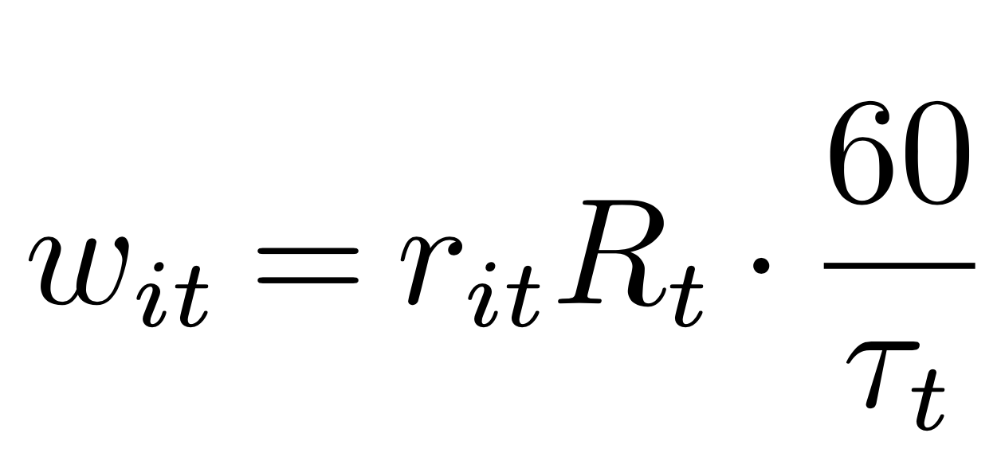
1
2
3
sum
1
Firm’s Policies
Managing Long-Term
Pay per Work
Dynamic Guaranteed Pay
Workers compensated for each work they performed (e.g., each rider trip)
Workers guaranteed a fixed rate of hourly compensation during the shifts as long as they stay online
How much should Pay per Work be to match outcomes of Guaranteed Pay (Base)?
Pay per work
“1x” rate
Dynamic guaranteed hourly rate
Average trip duration
P(getting a match)
Notes:
From the firm’s perspective, this policy transparently reflects the market conditions of supply and demand. Because workers are compensated based on the work that they actually perform, they seek to become available when jobs are available and not when work is scarce. This allows the firm to be fluid and respond quickly to real-time changes in demand (and supply).
However, this policy requires workers to constantly check the availability of jobs, and the platform might not be able to attract workers in time for surges in demand. From the workers’ perspective, when the utilization rate is low, the idle time they spend waiting for work is costly and encourages them to multihome or find better alternatives.
Second scheme, workers are guaranteed a fixed rate of hourly compensation during their shifts as long as they are actively available for work on the platform. Our focal company as well as the grocery delivery platforms GoPuff and Postmates are examples of platforms offering a dynamic hourly wage. This policy allows the firm to be more certain about its costs while attracting more loyal workers. DeVoe and Pfeffer (2007) has empirically shown that the certainty of incentives (through guaranteed hourly wages) can increase worker productivity and induce them to work for a longer period of time.
When demand is unexpectedly low, however, the supply of workers may not adjust despite low utilization. Even when they are not serving customers, workers stay based on their guaranteed compensation. Unlike pay per work, however, the firm bears the costs of mismatched supply. Furthermore, the segment of workers it attracts may be limited, e.g., only those who are averse to income uncertainty. We investigate this by estimating the frequency at which each worker stays working for the focal platform.

Slide 120
1
2
3
sum
1
Firm’s Policies
Managing Long-Term
Pay per Work
Dynamic Guaranteed Pay
Workers compensated for each work they performed (e.g., each rider trip)
Workers guaranteed a fixed rate of hourly compensation during the shifts as long as they stay online
How much should Pay per Work be to match outcomes of Guaranteed Pay (Base)?
Pay per work
“1x” rate
Dynamic guaranteed hourly rate
Average trip duration
P(getting a match)
“_x” rate = multiplier of 1x
Notes:
From the firm’s perspective, this policy transparently reflects the market conditions of supply and demand. Because workers are compensated based on the work that they actually perform, they seek to become available when jobs are available and not when work is scarce. This allows the firm to be fluid and respond quickly to real-time changes in demand (and supply).
However, this policy requires workers to constantly check the availability of jobs, and the platform might not be able to attract workers in time for surges in demand. From the workers’ perspective, when the utilization rate is low, the idle time they spend waiting for work is costly and encourages them to multihome or find better alternatives.
Second scheme, workers are guaranteed a fixed rate of hourly compensation during their shifts as long as they are actively available for work on the platform. Our focal company as well as the grocery delivery platforms GoPuff and Postmates are examples of platforms offering a dynamic hourly wage. This policy allows the firm to be more certain about its costs while attracting more loyal workers. DeVoe and Pfeffer (2007) has empirically shown that the certainty of incentives (through guaranteed hourly wages) can increase worker productivity and induce them to work for a longer period of time.
When demand is unexpectedly low, however, the supply of workers may not adjust despite low utilization. Even when they are not serving customers, workers stay based on their guaranteed compensation. Unlike pay per work, however, the firm bears the costs of mismatched supply. Furthermore, the segment of workers it attracts may be limited, e.g., only those who are averse to income uncertainty. We investigate this by estimating the frequency at which each worker stays working for the focal platform.

Slide 121
1
2
3
sum
1
Pay Schemes
Need 1.25-1.5x pay per work rate to match work duration of guaranteed pay
Work Duration (hours)
Guaranteed Pay
Pay per Work
Base
2.5-3x to keep most loyal workers
1.5-2x to keep those who switch 50%+
Guaranteed Pay
Guaranteed Pay
Pay per Work
Pay per Work
Base
Base
Notes:
Note that the regular pay-per-trip policy (1×) generally leads to a shorter work duration on the focal platform (22.04%). It would require the platform to increase the scaling factor between 1.25× and 1.5× in order to match the work duration under the base policy.
suggests the first benefit of the guaranteed pay: the firm can induce the workers to work for the same duration at a lower cost if the firm guarantees the earnings regardless of the number of trips.
Drivers who never switch to the competing platform when working for the focal firm can be considered as the most loyal group. We find that, to keep the same fraction of these loyal drivers as when offering the guaranteed pay, the pay-per-trip rate has be between 2.5× and 3× of the current hourly offer (see Figure 7a). In other words, a guaranteed pay scheme could save the platform up to 75% of the cost to maintain the same level of loyal drivers pool. Similarly, to keep the same fraction of drivers who switch most of the times, the pay-per-trip rate has to be between 1.5× and 2× (see Figure 7b).

Slide 122
Estimation Results
Discount factor | Population distribution of cost
$β$ = 0.94985 (0.00187) | $μ$ = 0.55358 (0.01145) | $σ$ = 0.664725 (0.01197)
$1 in 2 hours
→ 73 cents now
Low-cost
High-cost
UWS, LWS, Brooklyn
JFK Airport
Notes:
Now let’s take a look at our result. The final set of theta includes the discount factor beta which we estimated to be 0.92.
With these estimates, we can then compute the average cost for each individual driver [CLICK] conditional on their decisions we observed. So here is the distribution of the cost.
We observe 2 pretty distinct groups, so I’ll call them as Low-Cost vs High-cost. The mixes of vehicle types are similar, but they differ in the locations they start working for the day.
Via mostly in Manhattan
Get paid to go there using Uber (another platform) -> Downtown/Midtown
Queens – Brooklyn start from home
UWS/LWS coming in from Jersey
UES, Harlem, LES always popular

Slide 123
1
2
3
sum
Estimation Results
Discount factor | Population distribution of cost
$β$ = 0.94985 (0.00187) | $μ$ = 0.55358 (0.01145) | $σ$ = 0.664725 (0.01197)
66.59% most days
16.01% never
Fraction of workdays multihoming
42.23% always
P(switching to B) on average weekday
Hourly rate changes
Hourly rate changes
Hourly rate changes
Hourly rate changes

Slide 124
Multihoming… Good or Bad?
Notes:
A couple recent theoretical works show that it’s good because workers spend less time idling.
But another found that yes they work more but they also earn less.
It’s also bad for the firm given some cities like NYC, put a cap on the number of drivers. So multihoming means workers spend less fraction of their time working for you.
So here the goal is to Manage/Control multihoming.
[NEXT]

Slide 125
Multihoming… Good or Bad?
Workers spend less time idling. (Liu, Loginova & Wang 2017, Bryan & Gans 2018)
Workers work more but earn less. (Benjaafar, Xiao & Yang 2020)
Notes:
A couple recent theoretical works show that it’s good because workers spend less time idling.
But another found that yes they work more but they also earn less.
It’s also bad for the firm given some cities like NYC, put a cap on the number of drivers. So multihoming means workers spend less fraction of their time working for you.
So here the goal is to Manage/Control multihoming.
[NEXT]

Slide 126
Multihoming… Good or Bad?
Workers spend less time idling. (Liu, Loginova & Wang 2017, Bryan & Gans 2018)
Workers work more but earn less. (Benjaafar, Xiao & Yang 2020)
Notes:
A couple recent theoretical works show that it’s good because workers spend less time idling.
But another found that yes they work more but they also earn less.
It’s also bad for the firm given some cities like NYC, put a cap on the number of drivers. So multihoming means workers spend less fraction of their time working for you.
So here the goal is to Manage/Control multihoming.
[NEXT]

Slide 127
Multihoming… Good or Bad?
Workers spend less time idling. (Liu, Loginova & Wang 2017, Bryan & Gans 2018)
Workers work more but earn less. (Benjaafar, Xiao & Yang 2020)
How to control multihoming?
Notes:
A couple recent theoretical works show that it’s good because workers spend less time idling.
But another found that yes they work more but they also earn less.
It’s also bad for the firm given some cities like NYC, put a cap on the number of drivers. So multihoming means workers spend less fraction of their time working for you.
So here the goal is to Manage/Control multihoming.
[NEXT]

